Slide 1
TAVI: valve thrombosis in a patient with incomplete frame expansion
Anoop Mathew, MD
Robert Welsh, MD, FRCPC
Benjamin Tyrrell, MD, FRCPC
University of Alberta Hospital, Edmonton

Slide 2
Cilnical
Mr D is an 86-year-old gentleman who presented with NYHA class III exertional dyspnea and was recently diagnosed with aortic stenosis
PMHx: CABG in 1995 with LIMA to LAD, SVG to OM and SVG to RCA
Hypertension, dyslipidemia, in sinus rhythm
Severe aortic stenosis with peak and mean pressure gradients of 69 and 44 mmHg. Moderate PAH. Normal LV systolic function
He presented to the University of Alberta Hospital on October 4, 2017, for a TAVI procedure.

Slide 3
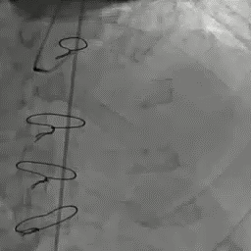
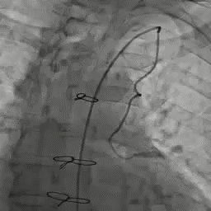
Patent LIMA to LAD

Slide 4
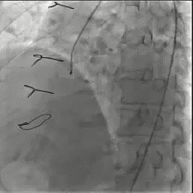
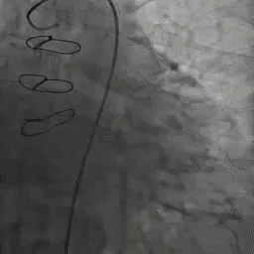
CTO of proximal RCA; patent SVG to OM and RCA

Slide 5
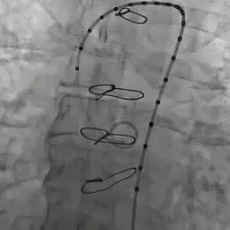
Aortic root angiogram

Slide 6
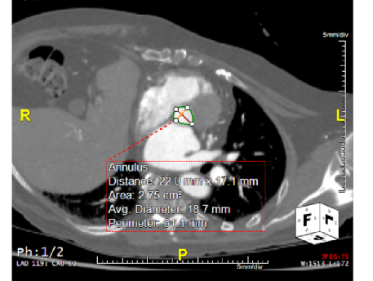
Key measurements:
Annulus area: 275 mm2
Diameter 22x17.1 mm
Perimeter 61.1 mm
Sinus width 21.3 mm
RCA height 9.68mm
LCA height 7.12 mm
Ascending aorta 25.2 mm

Slide 7
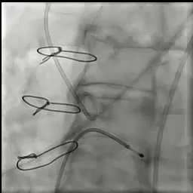
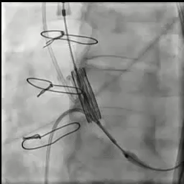
Implanted a 23mm balloon expandable valve trans-femorally

Slide 8
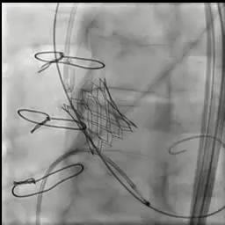
Post procedure echo in the cath lab
23 mm Edwards SAPIEN S3 bioprosthesis is seated well with at most trace paravalvular leak and a mean pressure gradient of 9 mmHg
Normal left ventricular systolic function.
No apparent complications.

Slide 9
Echo next day
There is a 23 mm Edwards SAPIEN S3 bioprosthesis in the aortic position. The bioprosthetic valve is functioning well with no paravalvular leak. The gradients across the valve are high with peak mean 35 / 20mmHg. Dimensionless index = 0.35 and AVA 1.0 with AVA indexed 0.6. This likely represents significantpatient prosthesis mismatch. Only if LVOT diameter were truly 23mm would AVA likely correct into more 'normal' zone without patient prosthesis mismatch.
Concentric left ventricular remodelling with hyperdynamic LV. The EF is visually estimated to be > 70%.
Mild diastolic dysfunction.
Anterior epicardial fat pad. No pericardial effusion.

Slide 10
1 month later
Brought by EMS in acute pulmonary edema and shock
Lactate 6.0, SBP 60 systolic, tachycardic

Slide 11
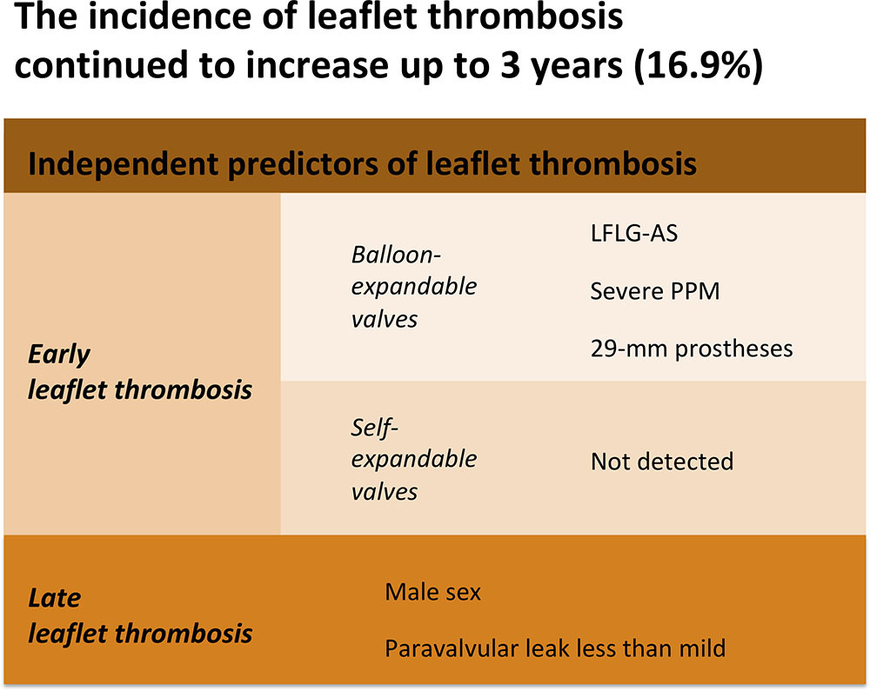
485 patients underwent 4-D multidetector CT post- TAVI to survey hypo-attenuated leaflet thickening with reduced leaflet motion compatible with thrombus at a median of 3 days, 6 months, 1 year, 2 years, and 3 years.
Incidence, predictors, and clinical outcomes of early (median 3 days) and late (>30 days) leaflet thrombosis were assessed.
WHAT THE STUDY ADDS
Untreated early (median 3 days) leaflet thrombosis did not affect hard end points, and late leaflet thrombosis occurred late up to 3 years.
Independent predictors of leaflet thrombosis may be related to local hemodynamic stasis on the leaflets.
Circulation: Cardiovascular Interventions. 2019;12:e007349

Slide 12
Bio-mechanistic studies: effect of under-deployment on valve durability
In the 2 and 3 mm under expanded devices, the TAV leaflets exhibited severe pin-wheeling during valve closure, which increased leaflet stresses dramatically, and resulted in accelerated fatigue damage of the leaflets. ≥2 mm (≥9.1%) under expansion, will significantly impact device durability.
Ann Biomed Eng. 2017 February ; 45(2): 394–404.

Slide 13
Echo Nov 2017
Critical aortic prosthetic valve stenosis withpeak gradient measuring 136 mmHg and mean of 71 mmHg. In the setting of recent valve implantation (Oct 4, 2017) this is concerning for acute valve thrombosis. Postoperative mean aortic gradient was 20 mm Hg (Oct 5/17)
Left ventricle was difficult to visualize but appears to have septal/anterior hypokinesis with LV ejection fraction visually estimated at 40-45%
Deterioration in LV ejection fraction likely secondary to high LV afterload

Slide 14
Significant improvement in aortic gradients within 3 hrs of lysis with tenecteplase,
mean gradient decreased to 40 mm Hg

Slide 15
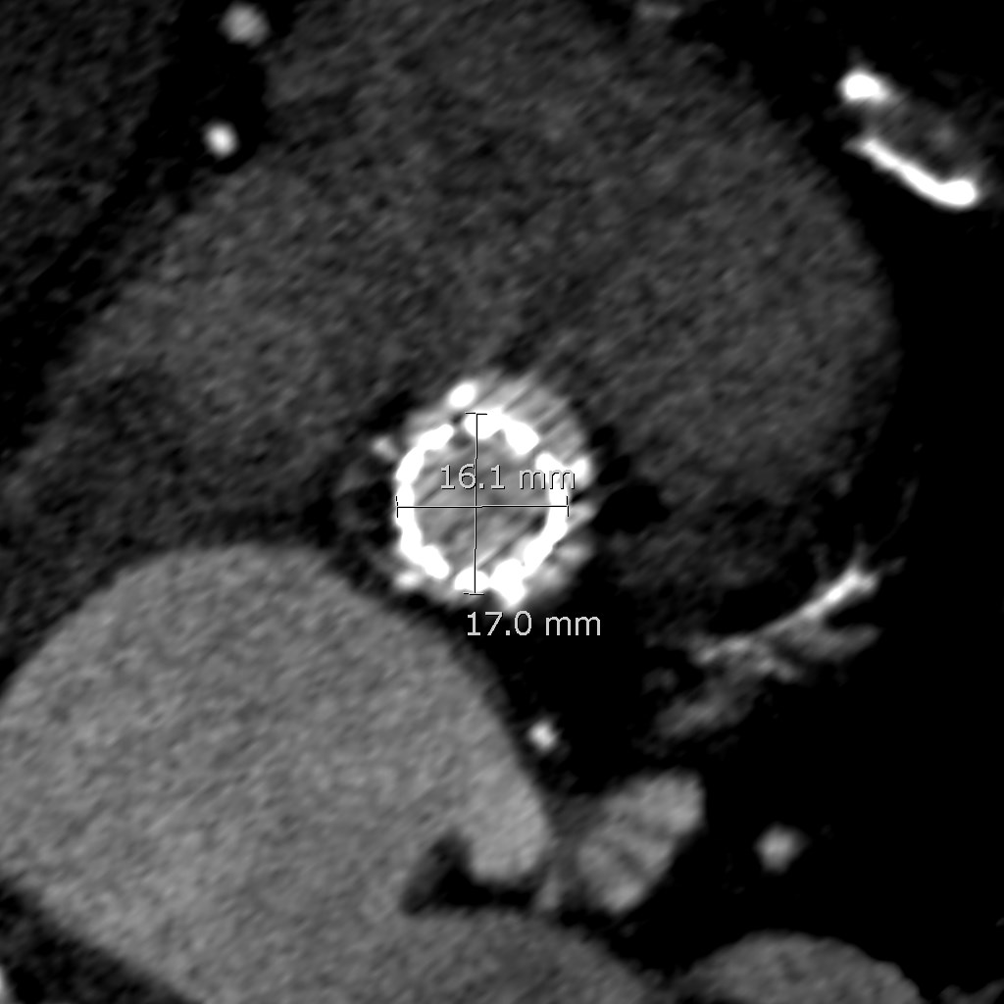
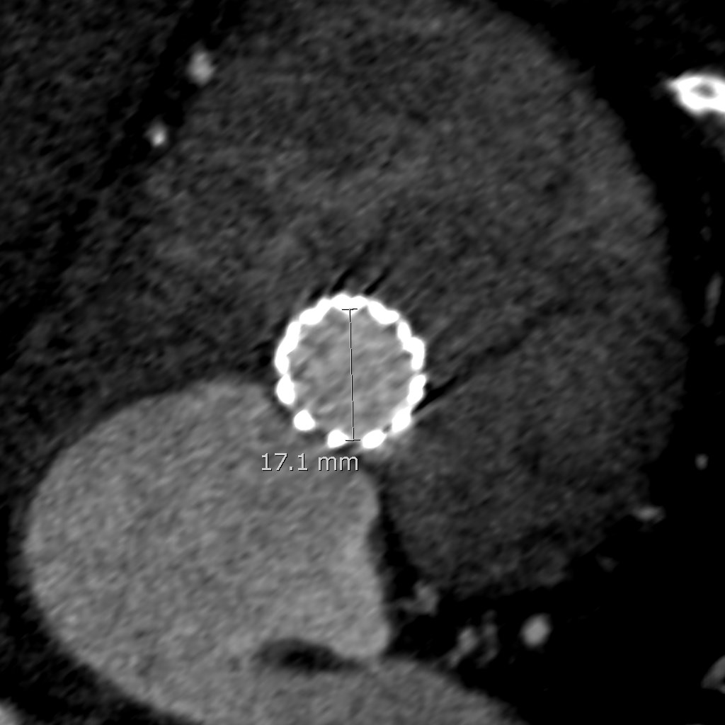
CT scan confirmed the presence of significant valve frame under-expansion

Slide 16
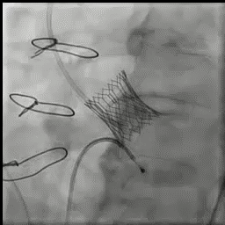
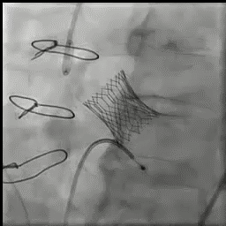
Decided to proceed with re-do TAVI with a 23mm balloon expandable valve

Slide 17
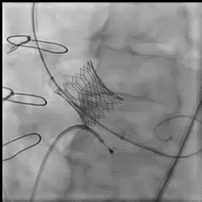
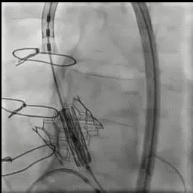
Pre-dilated the aortic valve>>significant AI>> proceeded with second 23mm valve implantation

Slide 18
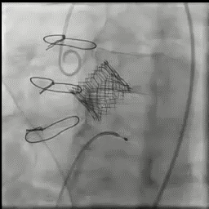
LCA completely occluded
No AI
Transient hypotension, recovering spontaneously
Had 4/10 chest pain

Slide 19
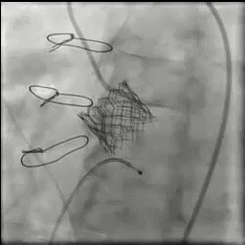
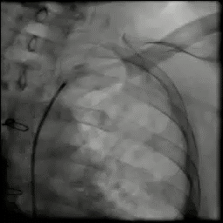
LIMA to LAD was patent

Slide 20
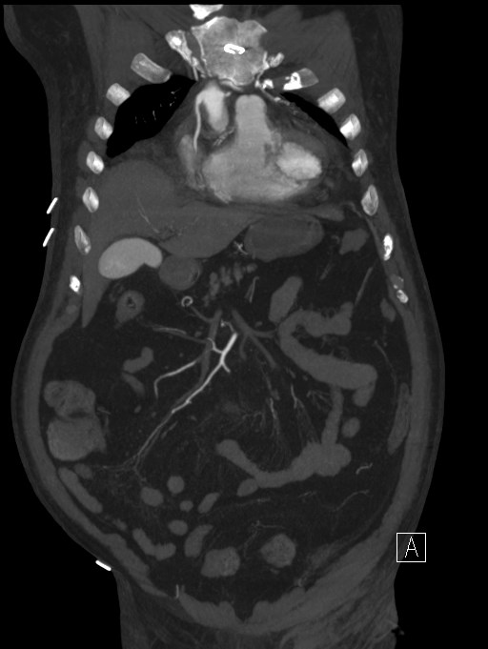
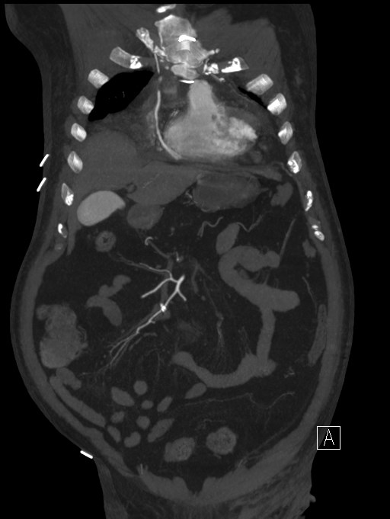
Patent SVG to RCA

Slide 21
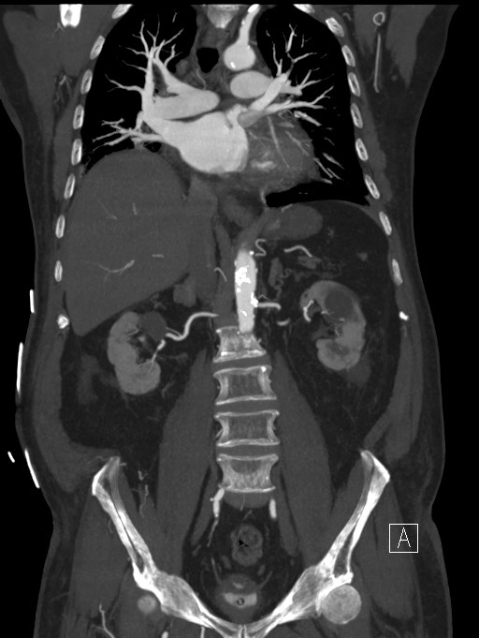
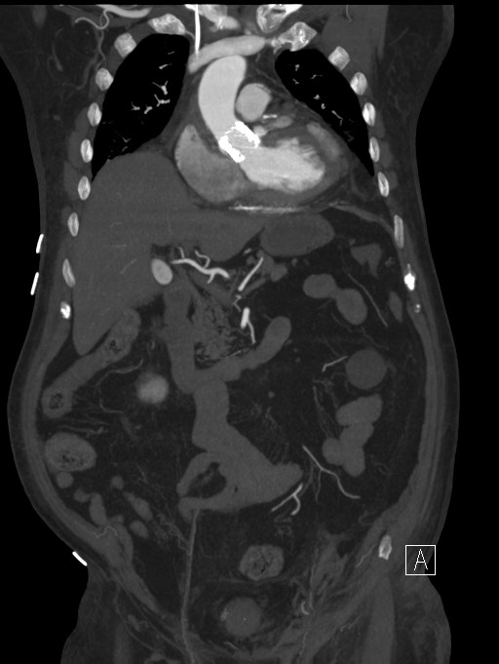
Patent SVG to OM

Slide 22
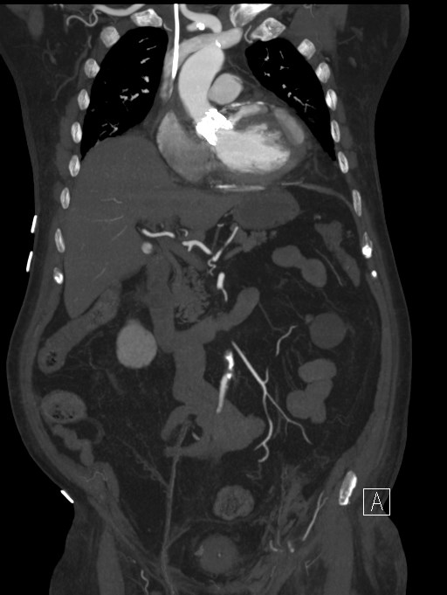
There was a contained track of contrast arising from the left lateral surface of the aortic root/TAVI stent, caudal to the LCA and coursing superficially along the left anterior-lateral surface of the LV
It measured approximately 8 cm in its transverse curvilinear length, 1.3 cm in AP diameter and 1.4 cm transversely.

Slide 23
Troponin peaked at 25mcg/L
Patient remained chest pain free from the second day
Small LV cavity. Mild concentric LVH.
Anterior- lateral hypokinesis. Hyperkinesis of most of the remaining segments. LVEF bySimpson's with contrast = 52%
Unfortunately, on 4th post procedure day patient had a cardiac arrest/PEA could not be revived.

Slide 24
Learning points
Suboptimal balloon prep may result in an under expanded TAVI valve, with risk of acute stent thrombosis
The presence of high-risk features for acute LM obstruction during re-do TAVI necessitates careful planning to pre-empt the same
Acute coronary occlusion during TAVI is rare (0.7 to 1% in native valves, 3.5% in valve-in-valve procedures) but is still often lethal with up to 41% 30-day mortality
Patients with anatomical risk factors, coexisting LM disease and previous bioprosthetic valves are at high risk
Different techniques described to maintain LM access in case of acute compromise

