Slide 1
CASE PRESENTATION
SAMER MANSOUR, MD.
Université de Montréal

Slide 2
Case
74 year old female patient
Transferred to our hospital for further management.
Admitted in a referring hospital for seizure/minor frontal stroke
PMH
HTN, DLP, DB
CKD stage IV not on HD (Cr: 180 micromole/l GFR:38 ml/min )
Anemia (Hb= 108 g/L) multiple polyps and diverticulosis
PAD:
severe abdominal infra-renal aortic stenosis, right common Iliac artery stenosis, right carotid artery stenosis, left vertebral artery stenosis
IHD with LVEF 32% and moderate to severe MR (Multiple hospitalization for heart failure)
In -hospital
Day 2: An episode of brady-asystole related to hyperkalemia/acute renal failure.
Day4: NSTEMI with recurrent chest pain (trop=220) , pulmonary edema with volume overload requiring IV nitro and diuretics
A coronary angiogram was performed and showed:

Slide 3
Coronary angiogram showing severe stenosis of the LM, Proximal LAD and LCx arteries
Aortography showing severe stenosis of the infra-renal aorta and of the right common iliac artery

Slide 4
Heart team meeting
1- High risk for surgical revascularization ( STS score 13.5 & Euroscore II 48.12 for in hospital mortality
2- Revascularize distal aorta and right common iliac artery first (mechanical support device)
3- PCI LM/LAD/ LCX (Syntax score 36)

Slide 5
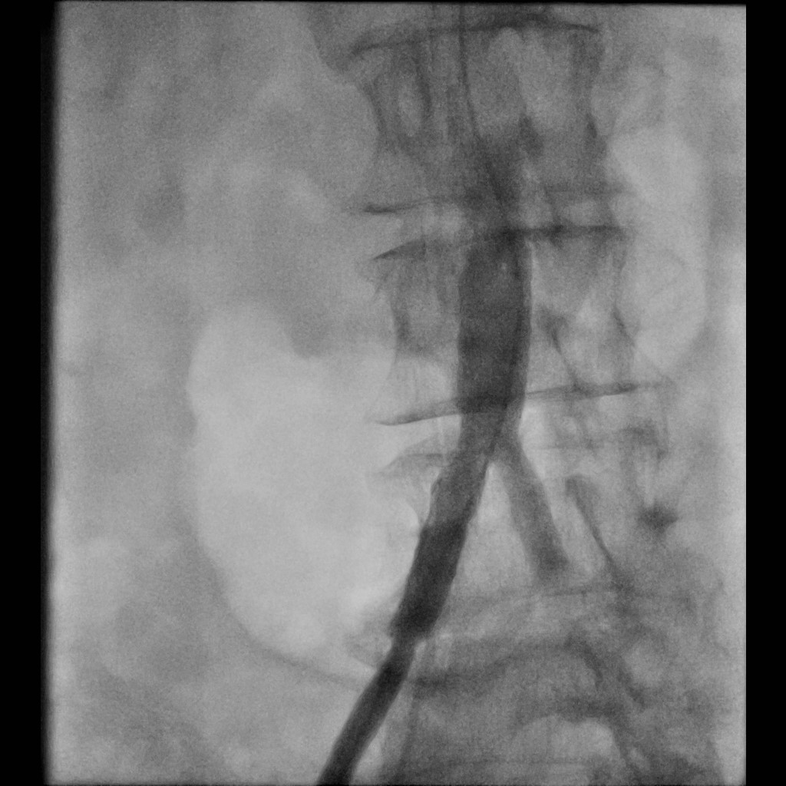
Post Angioplasty of the Abdominal Aorta and Right common Iliac artery with 2 stents

Slide 6
Coronary angiogram showing severe stenosis of the LM, Proximal LAD and LCx arteries
PCI of the LM toward LAD, PCI of the LCx with FKB
Disharged on DAPT (ASA & Clopidogrel.

