Slide 1
TAVI with Lotus Edge in a patient with low coronary ostium: A severe case of PTSD
J-François Gobeil MD
Cathlab director, CHUM
I2C Summit
October 25th 2019

Slide 2
Conflict of interest
None

Slide 3
Case #1
78 y/o women
HTN, arthrosis
STS 4.4:
→Bilateral breast cancer with mediastinal RÖRx in the past
TTE:
AVA: 0,6 mm2
Mean gradient: 60 mmHg
Normal EF
*Highly calcified leaflets, R>L
No CAD
Active, symptomatic
NYHA 2-3/4

Slide 4
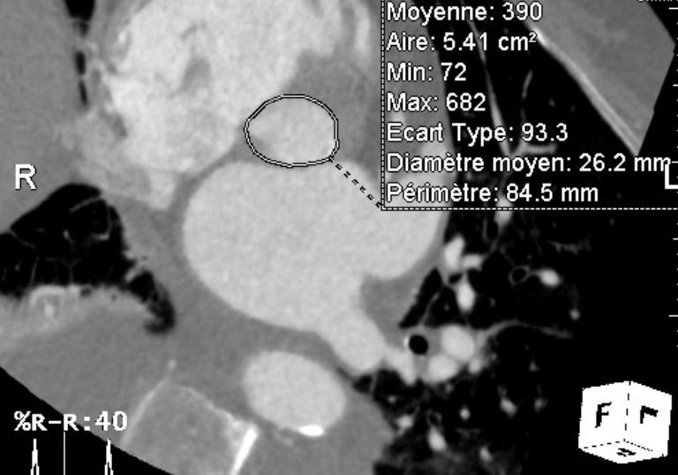
CASE 1
LCA height: 15.2 mm
Annulus area: 541 mm2
Mean SOV diameter: 32 mm
RCA height: 12.5 mm

Slide 5
Case 1, TTE

Slide 6
Question: Should we go ahead with TVH?
A- Yes
B- No
C- I don’t know

Slide 7
A few weeks before…

Slide 8
Case # 0.5
64 y/o women
Severe COPD: Waiting to be put on the transplant list
STS 5.4
TTE:
AVA: 0,8 mm2
Mean gradient: 45 mmHg
Normal EF / RV hypokinetic
PAP of 55 mm Hg
No CAD
NYHA 4/4

Slide 9
CASE 0.5 Measurements
LCA height: 11.8 mm
→Recalculated at 12.5 mm
RCA height: 10.3;
→Recalculated at 11.6 mm
Mean SOV diameter: 24.3 mm
EvolutR 23mm

Slide 10
CASE 0.5 EvolutR 23 mm positioning

Slide 11
CASE 0.5 EvolutR 23 mm final result

Slide 12
Case 0.5
30 minutes post-procedure, while going back to the ICU:
Chest pain
Severe hypotension
V-Fib
ACLS
Rushed back to the cathlab

Slide 14
Valve snared and pulled-out
Refractory V-tach / V-Fib
Shock
EMD

Slide 15
Post-Traumatic Stress Disorder (DSM IV)
“Mental health condition that is triggered by a terrifying event”
“Avoidance of places, people, and activities that are reminders of the trauma”
→Good treatment option?

Slide 16
Get back on your horse!!

Slide 17
The Next-Generation LOTUS Edge Valve System
Design Goals
Adaptive seal to provide surgical-like PVL
Controlled expansion
Consistent, stable delivery
Repositionable after 100% deployment
Early valve function for hemodynamic stability
Intra-annular valve
Limited depth of implant with Depth Guard™
Depth Guard
Adaptive Seal
Braided Nitinol Frame
Bovine
Pericardium
Leaflets

Slide 18
From LOTUS to LOTUS Edge: Design Features
Design Feature | LOTUS |  | LOTUS Edge
Adaptive Seal
Braided NiTi Frame
Early Valve Function
23mm, 25mm, & 27mm Sizes
Depth Guard™
One View Locking
Sheath | 18F ID |  | 15F ID
Delivery System | Pre-shaped |  | Flexible

Slide 19
Case 1, Lotus Edge 25mm, “positioning”
After balloon valvuloplasty

Slide 20
Case 1, Lotus Edge 25mm, final result

Slide 21
Coronary obstruction with TAVR
Incidence < 1% (0-1,2%)
Clinical risk factors:
Women
Age
No previous CABG
Higher Euroscore
Balloon expendable THV
ViV procedures
Ribeiro HB et al. JACC Interv 2013

Slide 22
Coronary obstruction with TAVR
(N=44)
Ribeiro HB et al. JACC 2013
Delayed coronary obstruction

Slide 23
Delayed coronary obstruction N=17,092 TAVR
Incidence: 0,22% (38)
Timing:
Within 24h: 47,4%
24h, to < 7 days: 15.8%
More than 7 days*: 36,8%
In-hospital death: 50,0%
Jabbour, JACC 2018

Slide 24
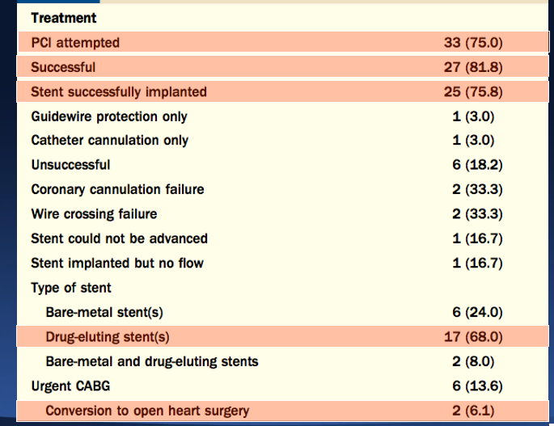
Coronary obstruction with TAVR
(N=44)
Ribeiro HB et al. JACC 2013

Slide 25
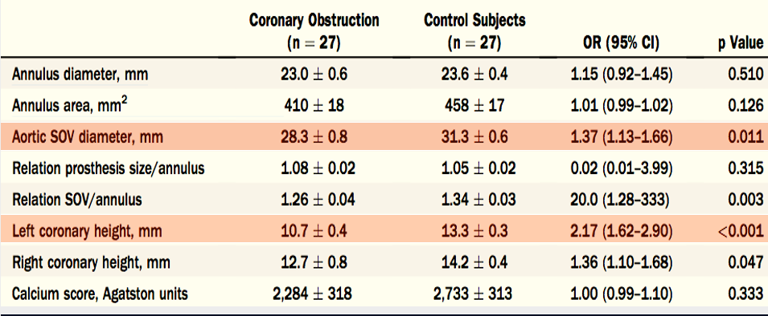
Coronary obstruction anatomic risk factors
Case-matched analysis
Ribeiro HB et al. JACC 2013

Slide 26
Conclusions
Coronary obstruction following TAVR is a rare but deadly complication
More frequent in women, older patient, ViV and with balloon expandable THV
Usually occurs acutely, but can be delayed
Known anatomic risk factors are:
Left coronary height < 12 mm (probably the same for RCA)
SOV diameter < 30 mm
→ When both present: Consider not performing the case
Other factors to consider:
Annulus size
Leaflet size and calcifications
STJ size and height

Slide 27
Conclusions
Being well prepared is the best treatment:
Balloon valvuloplasty with aortography pre-valve implantation
Guidewire protection
Avoiding balloon expandable THV
Using fully repositionable THV
Basilica procedure (ViV)
PCI is usually effective for treatment of coronary obstruction
Hemodynamic support often necessary
→Don’t let PTSD influence your decisions!

