Slide 1


A Case of Multivessel – LM PCI … or Not?
Erick Schampaert, MD

Slide 2

Disclosure statement
Within the past two years:
X
I, Erick Schampaert, have had an affiliation (financial or otherwise) with a commercial organization that may have a direct or indirect connection to the content of my presentation. Details below.
Type of Relationship | Organization Name
 | Modest (less than $10K) | Significant (greater than $10K)
A - Consulting Fees/Honoraria | Abbott Vascular, AstraZeneca, Bayer, Boston Scientific, Medtronic, Servier, Philips
B - Officer, Director, Or In Any Other Fiduciary Role
C – Clinical Trials |  | Abbott Vascular
D - Ownership/Partnership/Principal
E - Intellectual Property Rights
F - Other Financial Benefit : Educational Grants for Coronary Physiology and Imaging Symposium: CPI |  | Abbott Vascular, Boston Scientific, Opsens, Philips

Slide 3
A Case of …
Erick Schampaert, MD

Slide 4
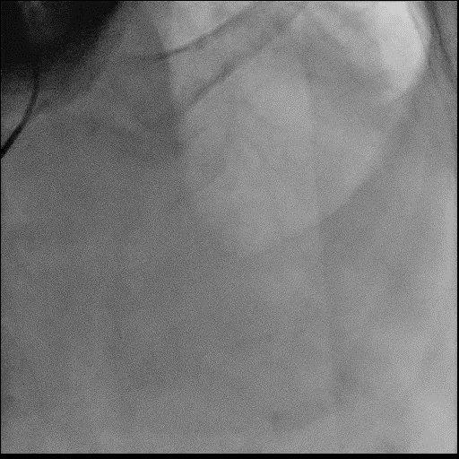
A Case of …
Tandem Lesions

Slide 5
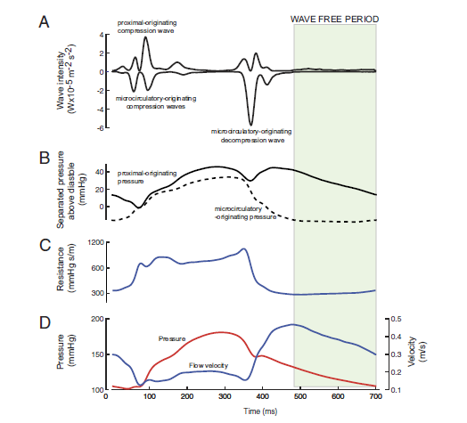
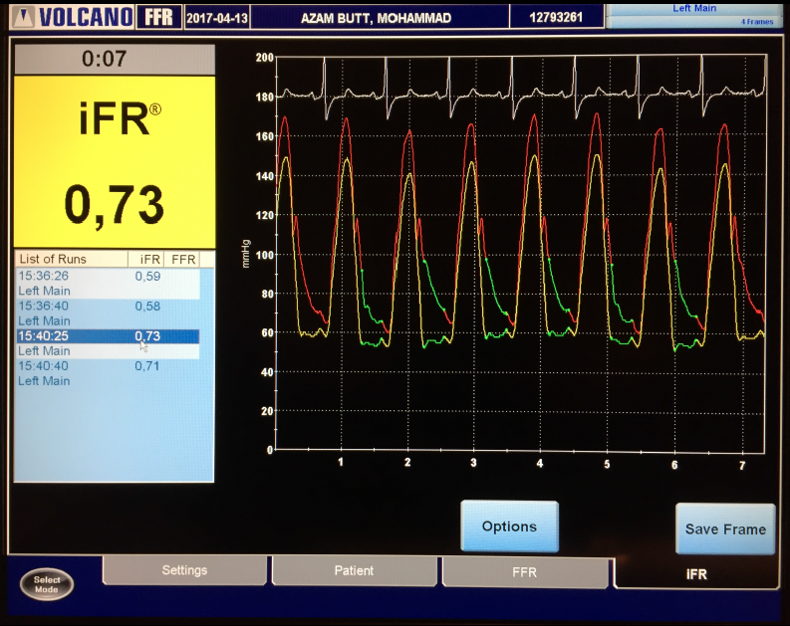
iFR
instantaneous wave-Free pressure Ratio (Pd/Pa) measured at Rest,
during 75% of diastolic wave-free period of each single beat.
(When resistance is naturally constant & minimized, and flow maximized).
75% Diastole
Wave-free period
75% of Diastole
Pa
Pd
Sen, Davies et al. JACC 2012; 59
de Waard EuroInterv 2017; 13: 450
Notes:
Remember that iFR is defined as the instantaneous wave free ratio across a stenosis during the wave free period during the cardiac cycle. This means iFR is measured during maximum flow velocity during the cardiac cycle and less susceptible to noise than whole cycle Pd/Pa.
In the wave-free period, when coronary resistance is stable, coronary pressure and flow are linearly related; therefore, pressure can be used as a surrogate for flow to assess coronary stenosis.¹
iFR is the most validated hyperaemia-free index to assess whether a stenosis is causing a limitation of blood flow in coronary arteries with subsequent ischemia.²
Reference:
Nijjer SS et al. Advances in coronary physiology. Circulation. 2015; 79:1172-84.
Sen S, Davies JE. Integrating physiology into the DNA of coronary revascularisation – a historical perspective, contemporary review and blueprint for the future of coronary physiology. Interven Cardiol Rev. 2015;10:79-84.ycle Pd/Pa

Slide 6
iFR, due to Minimal Lesion Interaction, is most Useful to Assess Serial Lesions
Hyperemic Flow
FFR
Increase in hyperemic flow after PCI of B:
FFR value will ↓
Coronary Flow
Rest Flow
Minimal change in
rest flow after PCI of B:
Same iFR value
iFR
(instantaneous wave-free period)
A
Stenosis Severity
A
B
Pre-PCI
A
Post-PCI
Nijjer iFR Pullback CV Revasc Medicine 2015 16 167

Slide 7
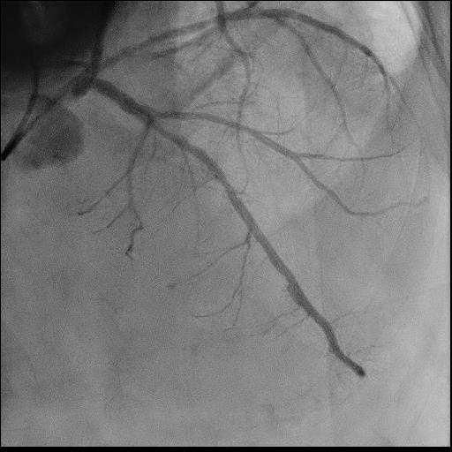
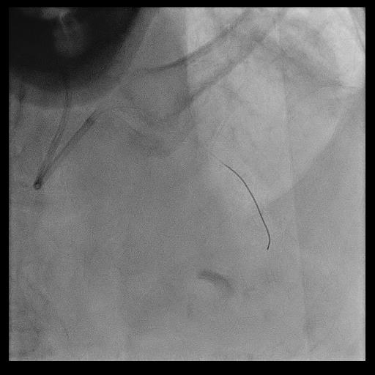
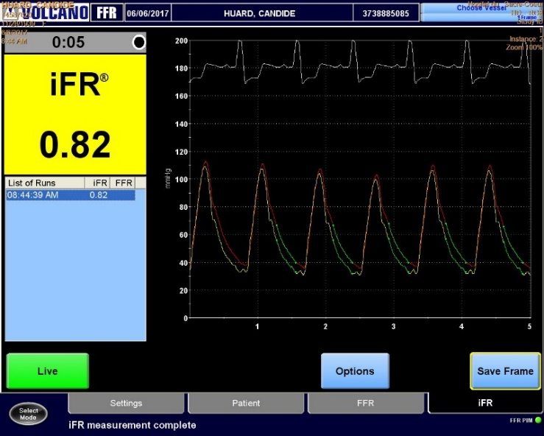
A Case of Tandem Lesions…
Distal LAD iFR

Slide 8
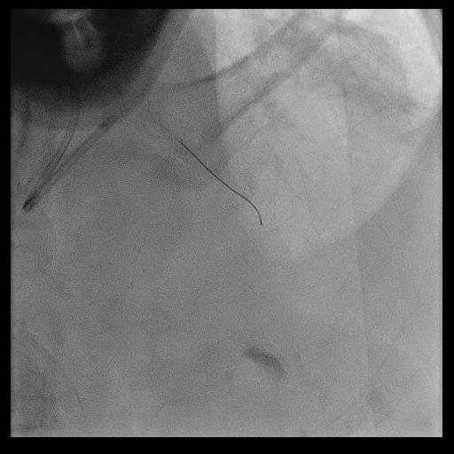
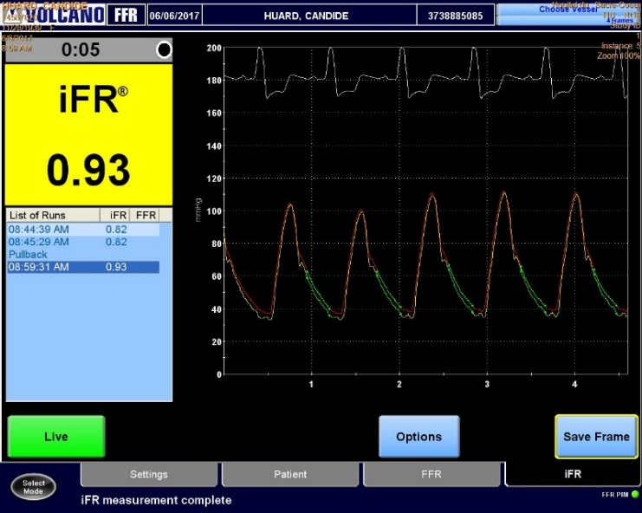
A Case of Tandem Lesions…
Prox. LAD iFR

Slide 9
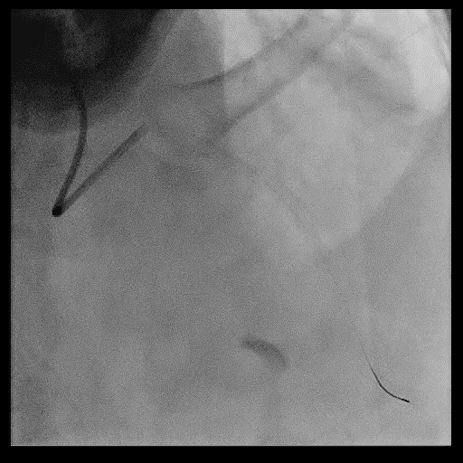
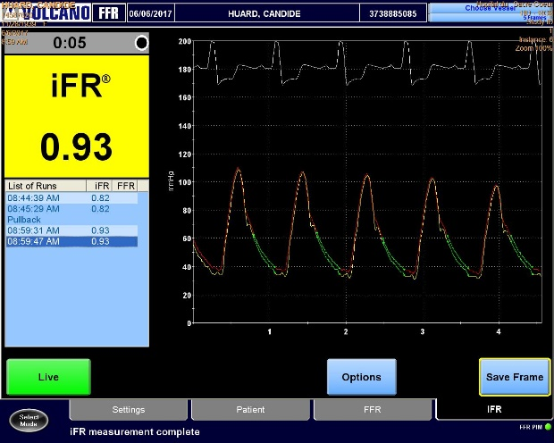
A Case of Tandem Lesions…
Post-DES LAD iFR
Asympto.
At 2Y F/U
09:28:33 AM 0.93

Slide 10
Another Case of …
62 ♂
HLP, HTN, Active Smoker
2008: CMP, 38% LVEF post - Ant STEMI: CCS 0 on OMT.
2019/07/29: CP Arrest: CPR – AED: X 3
ECG: Rapid A.F, no STEMI
Hemodynamically stable and neurologically intact
Tropo.I: 0.43, Cr: 74, CBC: N
Coronary Angiogram

Slide 11
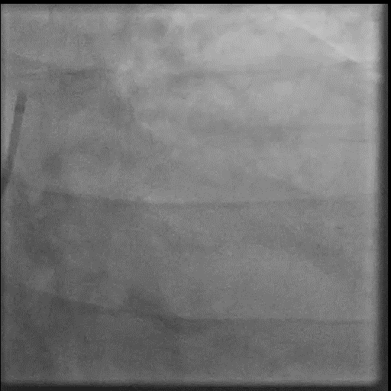
Another Case of …

Slide 12
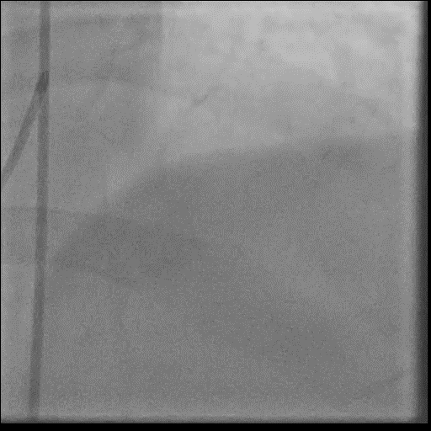
Another Case of …

Slide 13
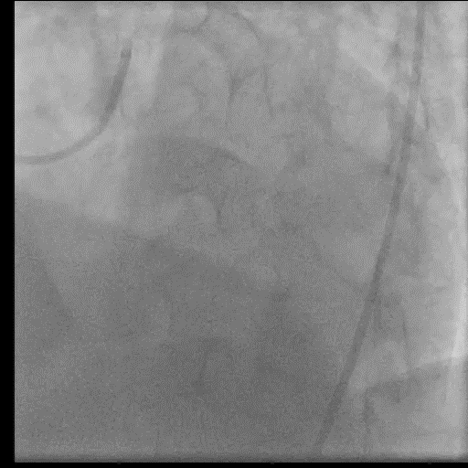
Another Case of …

Slide 14
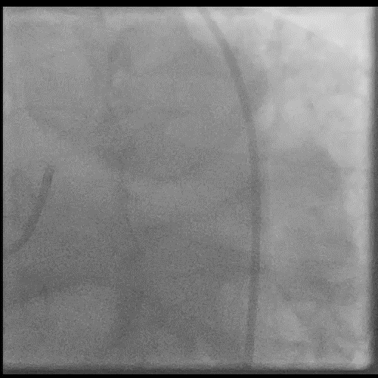
Another Case of …

Slide 15
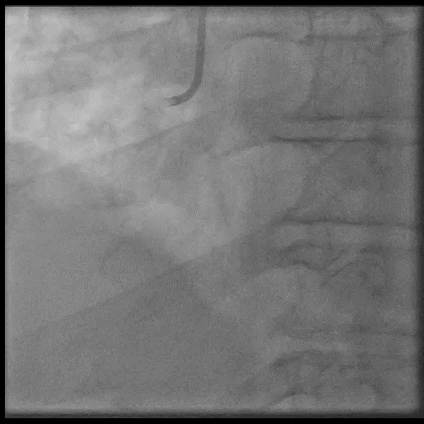
Another Case of …

Slide 16
A Case of Multivessel – LM …
62 ♂
Coronary Angio:
  Severe distal LM – ostial LAD – ostial LCX
  Complex LCX – OM1 – OM2 Bifurcation
  Significant distal RCA
LVEF: 33%, Ant. Akinesis.
A.F.: CHADS₂ : 1-2/6

Slide 17
A Case of Multivessel – LM …
Next?

Slide 18
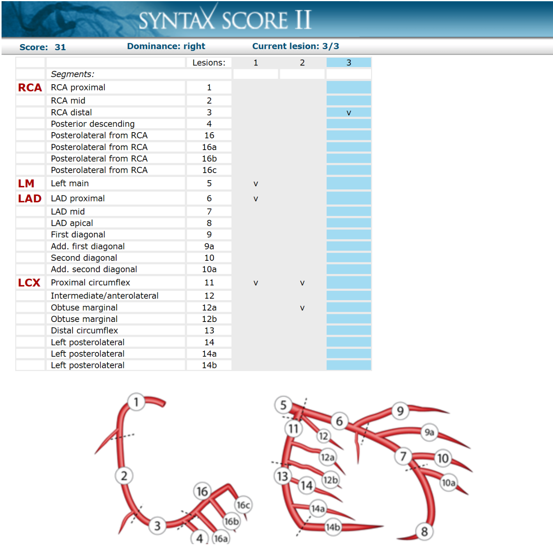
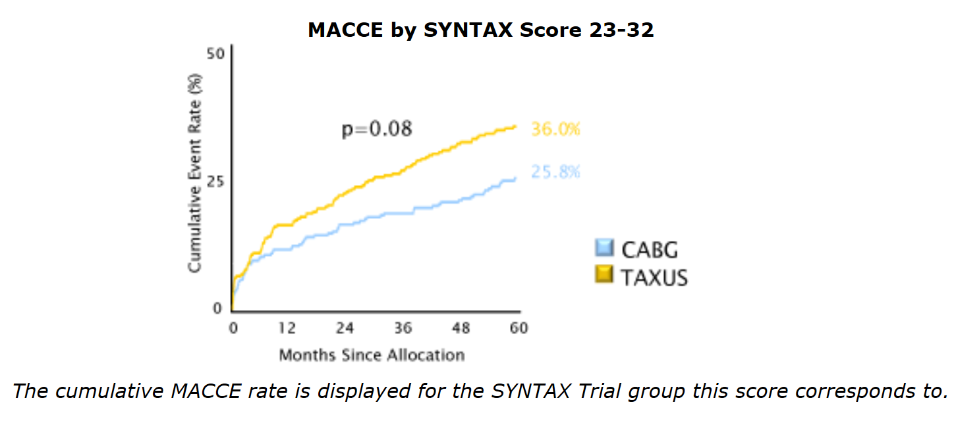
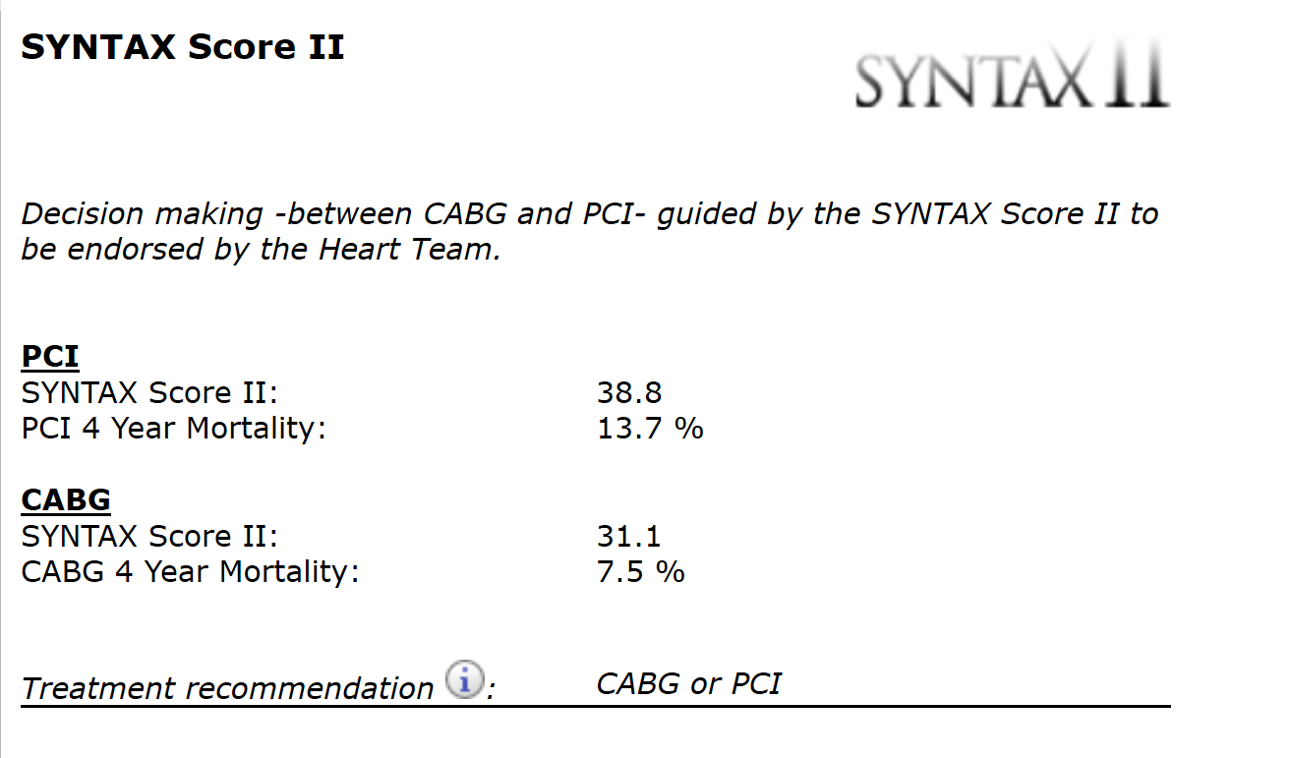
A Case of Multivessel – LM …
SYNTAX Score: 31

Slide 19
A Case of Multivessel – LM …
Pt Requested PCI:
By Angio, Dilate What?
  Complex LCX – OM1 – OM2 Bifurcation
  Severe distal LM – ostial LAD – ostial LCX
  Significant distal RCA

Slide 20
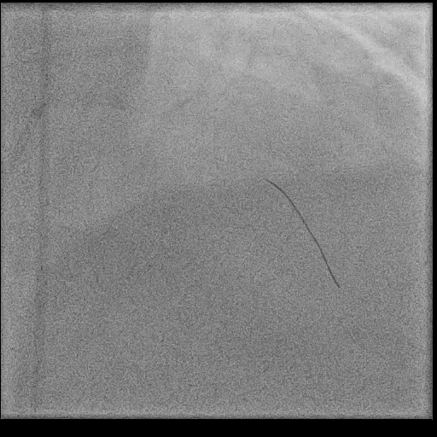
A Case of Multivessel – LM …
LAD iFR
iFR=0.88

Slide 21
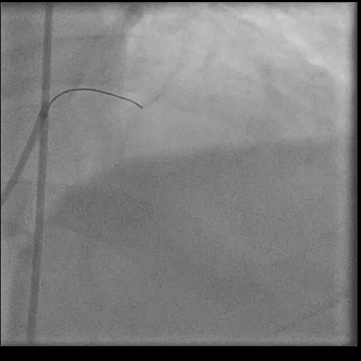
A Case of Multivessel – LM …

Slide 22
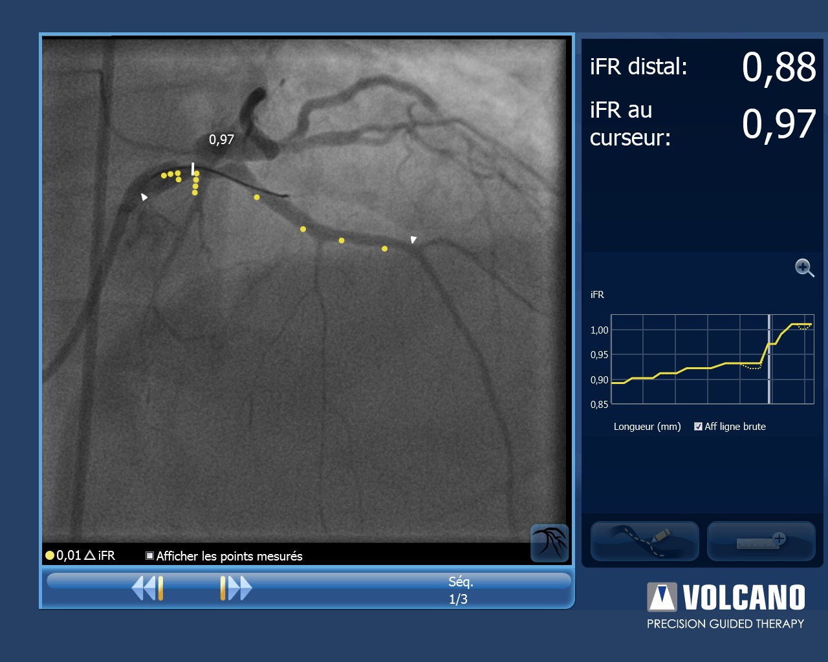
A Case of Multivessel – LM …
LAD iFR with Co-Registration

Slide 23
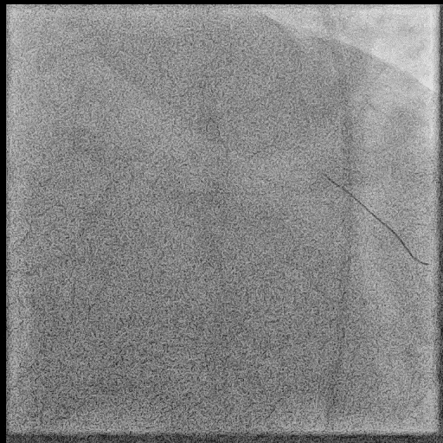
A Case of Multivessel – LM …
LCX iFR
iFR=0.87

Slide 24
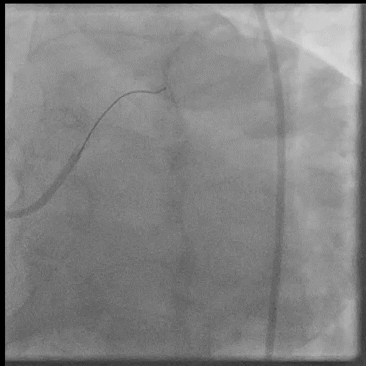
A Case of Multivessel – LM …

Slide 25
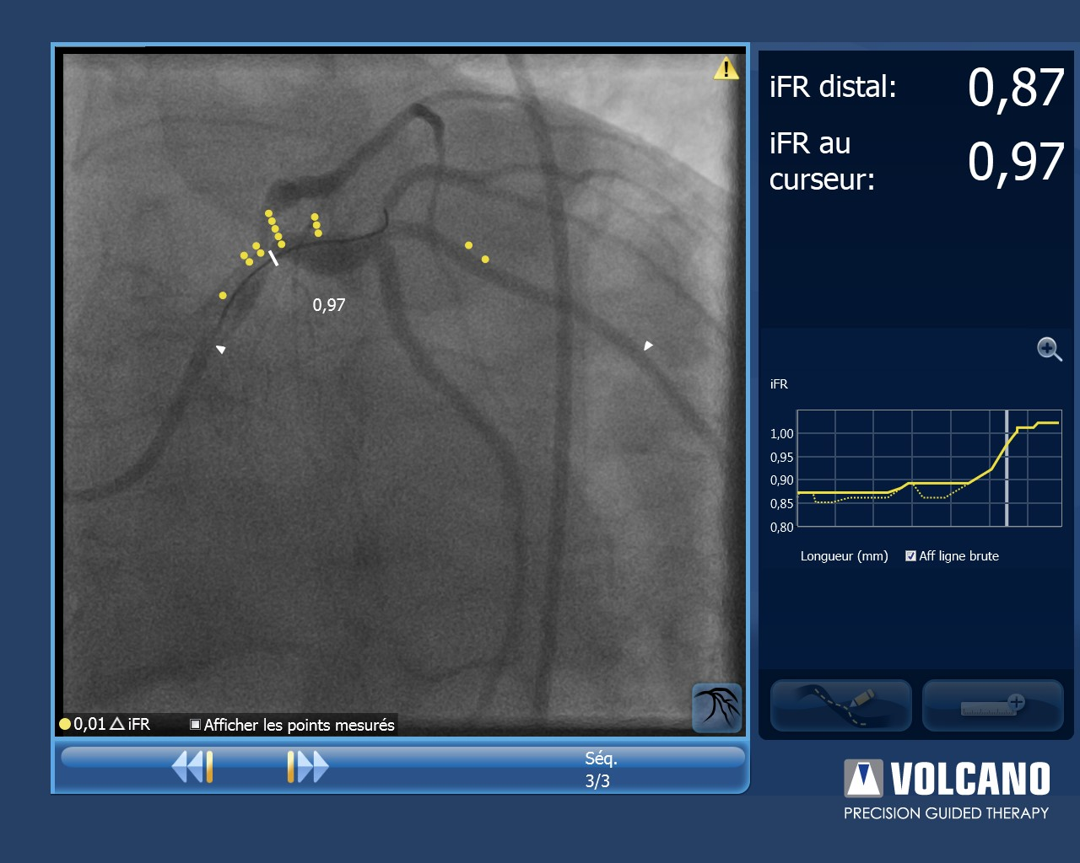
A Case of Multivessel – LM …
LCX iFR with Co-Registration

Slide 26
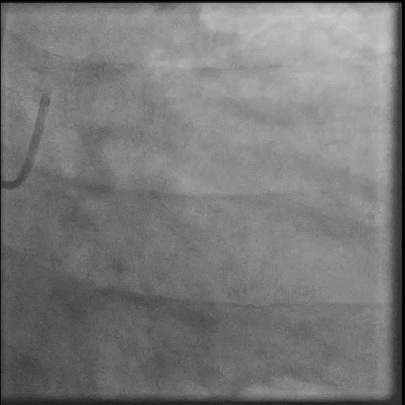
A Case of Simple LM PCI …
TAP LAD:
DES 3.5-12
LCX-LM:
DES 4.0-15
Kissing:
LAD: 3.5
LCX: 4.5
POT: 5.0

Slide 27
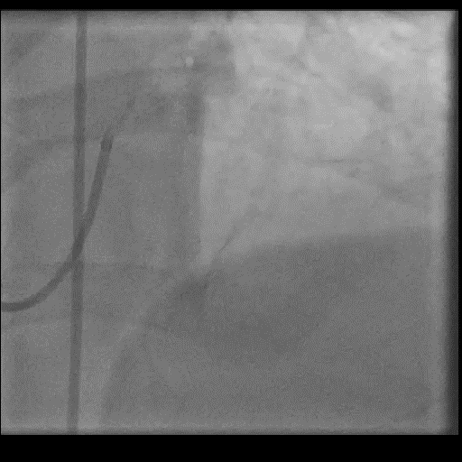
A Case of Simple LM PCI …
TAP LAD:
DES 3.5-12
LCX-LM:
DES 4.0-15
Kissing:
LAD: 3.5
LCX: 4.5
POT: 5.0

Slide 28
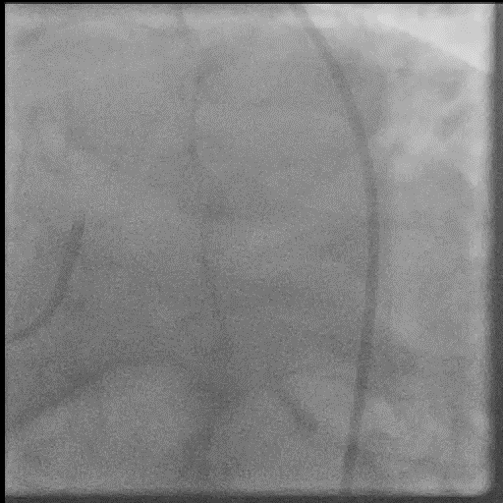
A Case of Simple LM PCI …
TAP LAD:
DES 3.5-12
LCX-LM:
DES 4.0-15
Kissing:
LAD: 3.5
LCX: 4.5
POT: 5.0

Slide 29
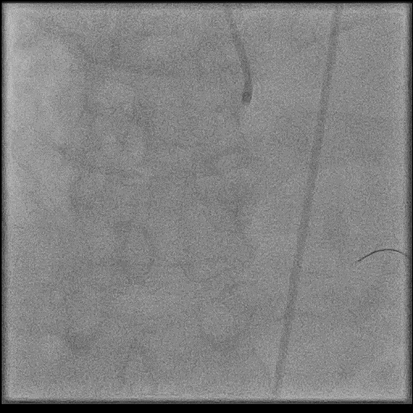
A Case of Simple LM PCI …
RCA
iFR: 0.99
AICD
before D/C
Apixaban 5²
+
Clopidogrel
Well
At
3 month F/U

Slide 30
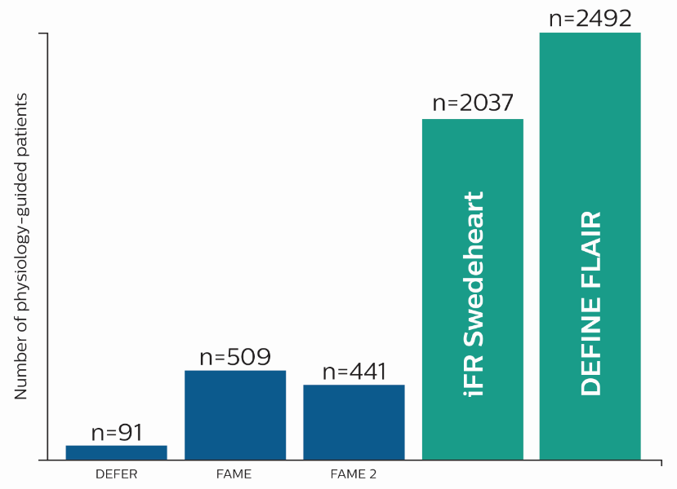
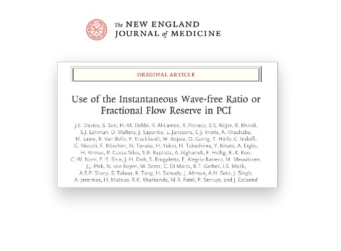
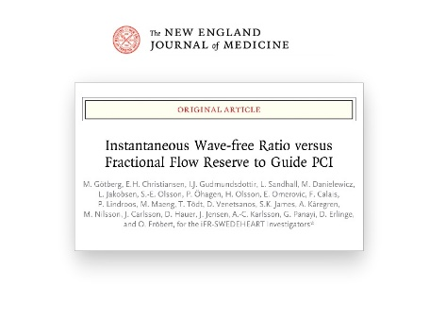
The 2 Largest Global Physiology Studies
DEFINE FLAIR and iFR Swedeheart are the new landmark physiology studies
4500+ patients, more than twice combined pts population of previous landmark physiology studies
  DEFINE FLAIR: n = 2492 patients
  iFR Swedeheart: n = 2037 patients
2 prospective, RCTs
Davies et al, Gotberg et al. NEJM 2017 March 18

Slide 31
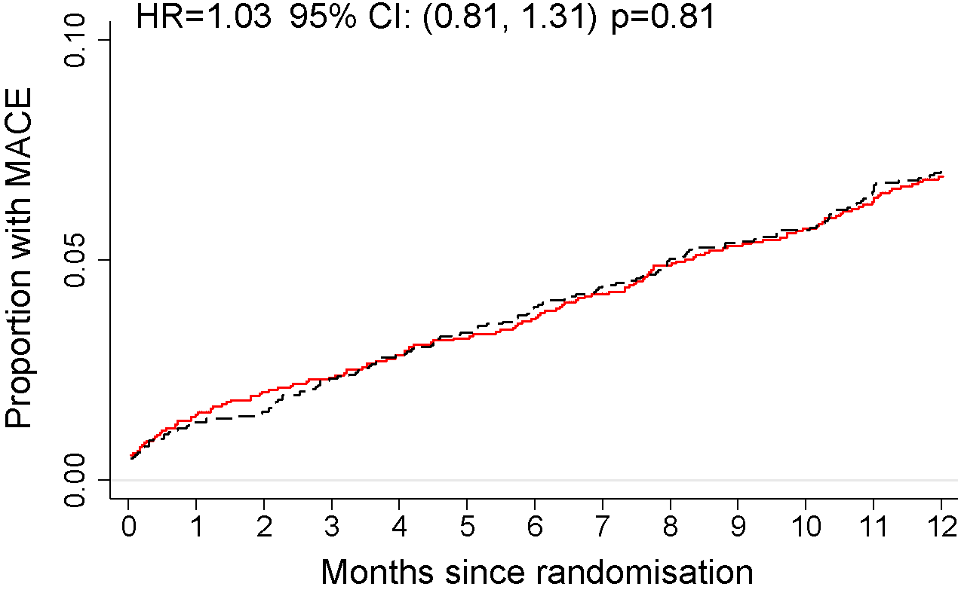
MACE with iFR-Guided vs. FFR-guided Revascularization: All patients
IFR 6.47%
FFR 6.41%
N=4486
Davies et al, Gotberg et al. NEJM 2017 March 18

Slide 32
iFR for LM Assessment
DEFINE - LM Registry
Warisawa: TCT 2019 . High Impact Clinical Research VII 2019.9.28

Slide 33
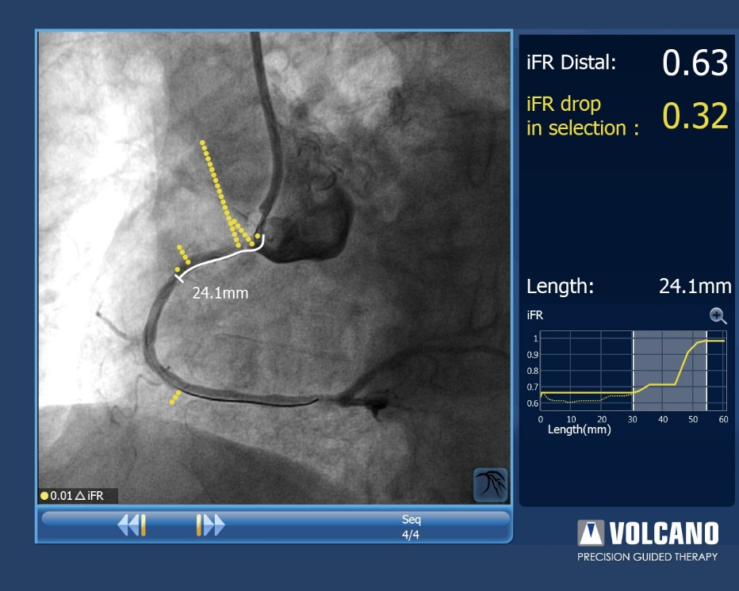
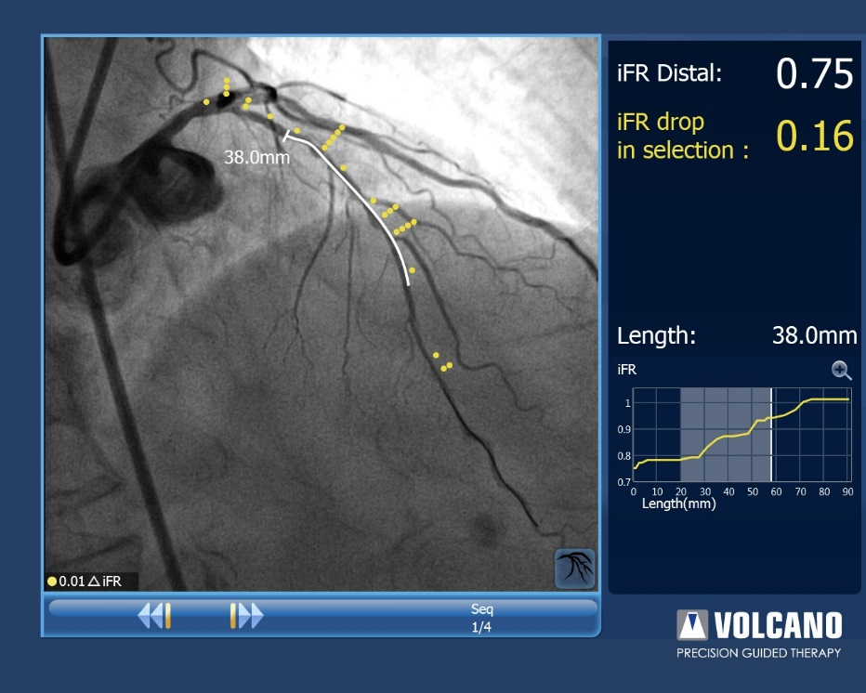
iFR Pullback, with Co-Registration
iFR co-registration graphically displays the iFR pullback changes, recalibrated along the angiogram by fluoroscopic pullback, providing precise location and individual ischemic contribution of each lesion.
Focal Disease
Diffuse Disease

Slide 34
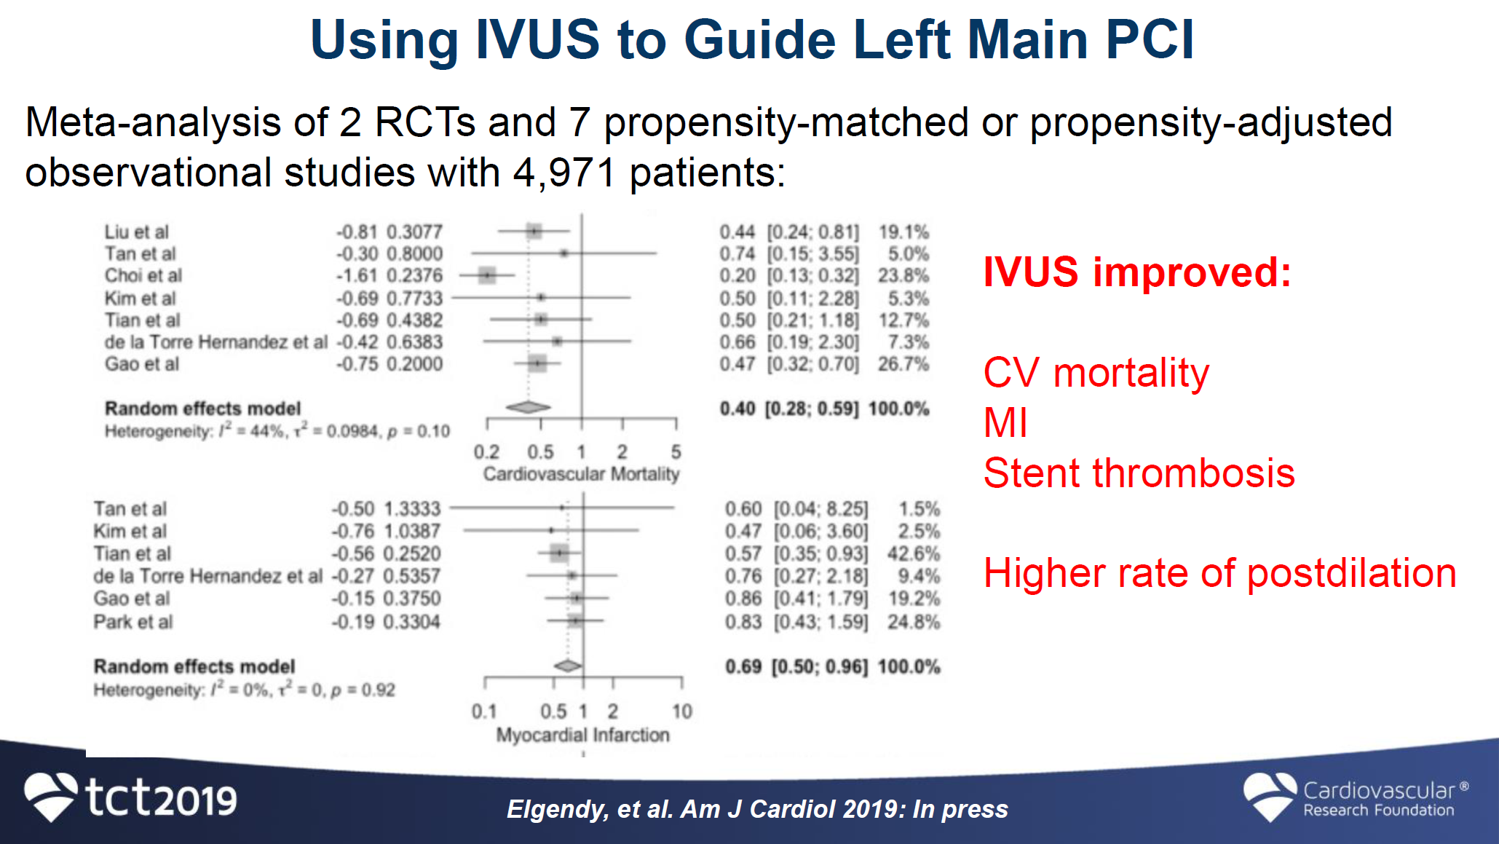
IVUS-Guided DES PCI for LM
Elgenday AJC 2019; PAOP

Slide 35
Conclusion
DEFINE-FLAIR and iFR-SWEDEHEART, comparing
iFR- vs. FFR-Guided Revascularization, in 4500 pts,
documented similar good outcomes at 1-2 years.
DEFINE-LM validates iFR application for the LM.
3. iFR pull-back, with co-registration, provides
precise location and ischemic contribution
of each individual lesion, to guide PCI: Simpler LM PCI.
4. IVUS-Guided LM PCI, improving outcomes, encouraged.

Slide 36






21th Canadian
Coronary Physiology & Invasive Imaging Symposium Montréal, Feb. 4-5th, 2020
A Case-Based, Basics to Advanced Knowledge Review
CPI 2020
International Faculty
Javier Escaned, Justin Davies, Allen Jeremias, Nils Johnson, Gary Mintz, Joost Daemen, Ron Waksman
In Collaboration with
23th
6.25 CME Credits
Xpertize Meeting Management
P: 514-696-6699, F: 514-696-6689, xpertize@xpertize.com

Slide 37
Thank You for Your Attention

