Slide 1
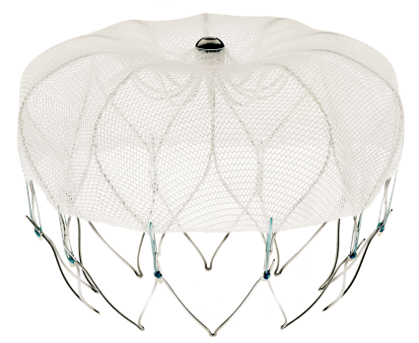
Sizing an LAA occlusion device Watchman may need more flex (and how to use ICE to guide implantation)
Jean-Bernard Masson, MD
Jeannot Potvin, MD
Jean-Marc Raymond, MD
Centre Hospitalier de l’Université de Montréal

Slide 2
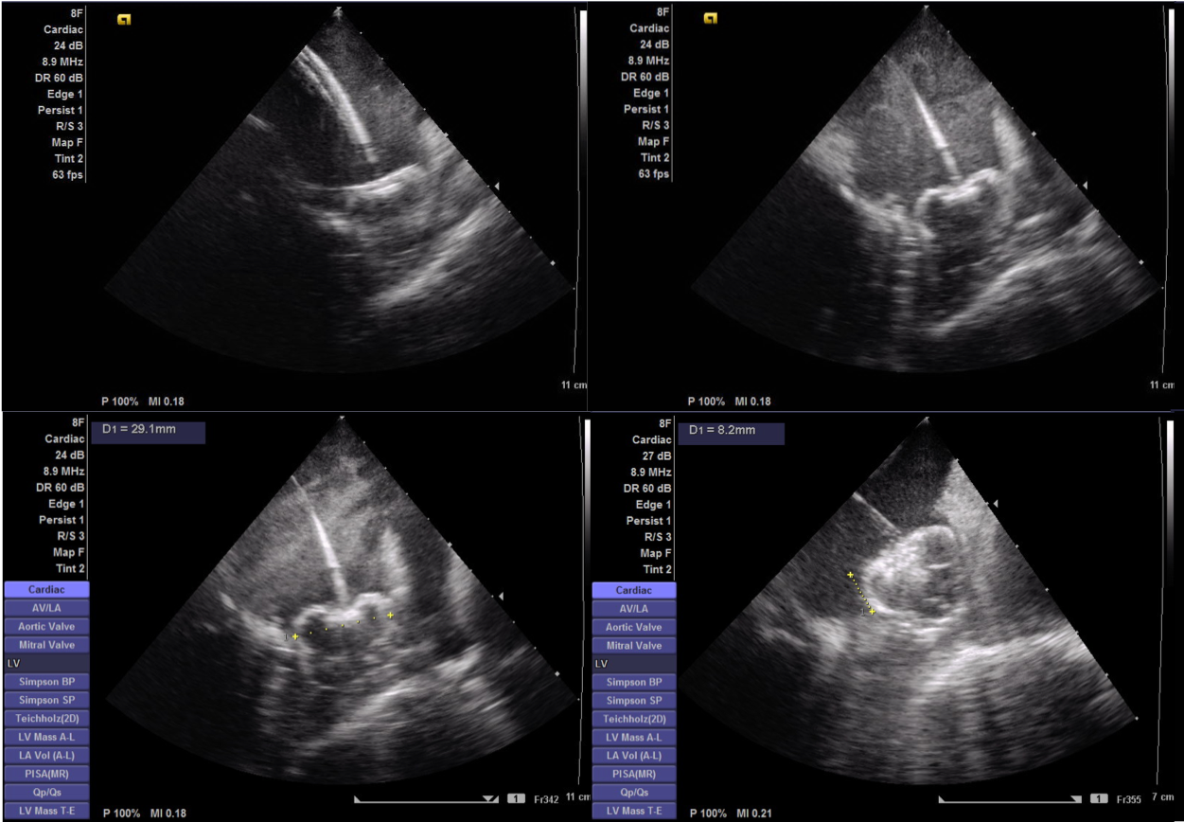
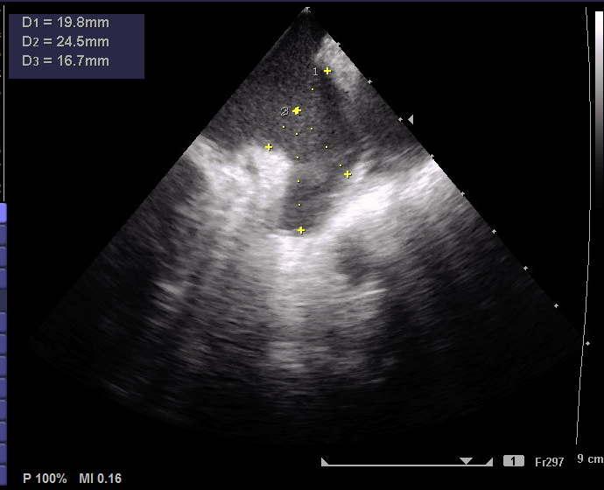
Topics
ICE GUIDANCE FOR WATCHMAN IMPLANTATION
SIZE SELECTION, LIMITATION OF CURRENT DEVICES AND POTENTIAL OF FLX

Slide 3
Case presentation
75 yo woman
CHADS 3 chronic AF
Multiple GI bleed
Moderate COPD
Normal LV, dilated LA

Slide 4
LAA angiography
LAO-cranial
LAO-caudal
Notes:
Anatomy description

Slide 5
LAA ostium and depth measurements

Slide 6
Delivery catheter positioning

Slide 7
Device assessment - Watchman 24 mm
Notes:
Shoulder 12 mm but device is otherwise deep enough and stable on pulltest

Slide 8
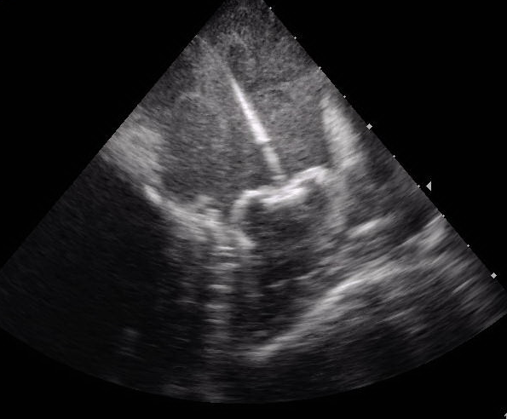
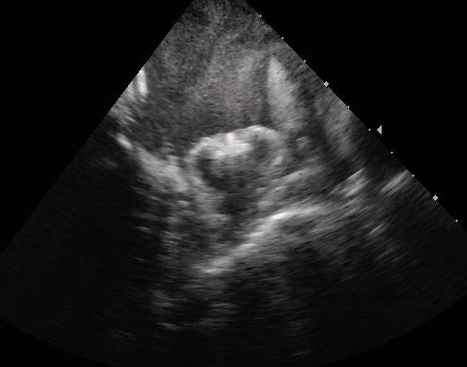
PASS CRITERIA with ICE
Position – device is at the ostium of the LAA
Anchor – fixation anchors engaged / device is stable

Slide 9
Stable device with 12 mm shoulder
50%
65%

Slide 10
2nd device assessment
Notes:
Shoulder now is 8 mm but

Slide 11
PASS CRITERIA with ICE
Size – device is compressed 8-20% of original size
Device Size | Maximum (20%) | Minimum (8%)
21 mm | 16.8 mm | 19.3 mm

Slide 12
PASS CRITERIA with ICE
Seal – device spans ostium, all lobes of LAA are covered

Slide 13
TEE vs ICE guidance
Criteria | Definition | Manufacturer’s description (TEE) | ICE
Position | Watchman is located at or inside the ostium | Device should be at or just distal to the LAA ostium | Device positioning is readily evaluated with ICE from the LUPV or mid-LA position. Left and right tilt (with or without clock and counter-clockwise rotation will assess the whole device. The left circumflex artery is also easy to find with ICE.
Anchor | Device returns to original position after gentle pull on deployment knob | To test stability, gently retract deployment knob and let go, observe device returns to original position | ICE from LUPV or mid-LA location and fluoroscopy provide good visualisation of device movement.
Size | Device “shoulder” diameter is 8-20% less than device size. | Measure in-situ device diameter at approximate TEE angles of 0, 45, 90 and 135 degrees to accurately assess device compression | ICE from the LUPV and fluoroscopy provide reproducible measurement.
Seal | No residual flow is seen around the device | Residual flow around the device of ≤ 3mm acceptable. | Color-doppler capacities of ICE are not that of TEE. In our experience, search for 2D gaps around the device has been more reliable.

Slide 14
45 days TEE

Slide 15
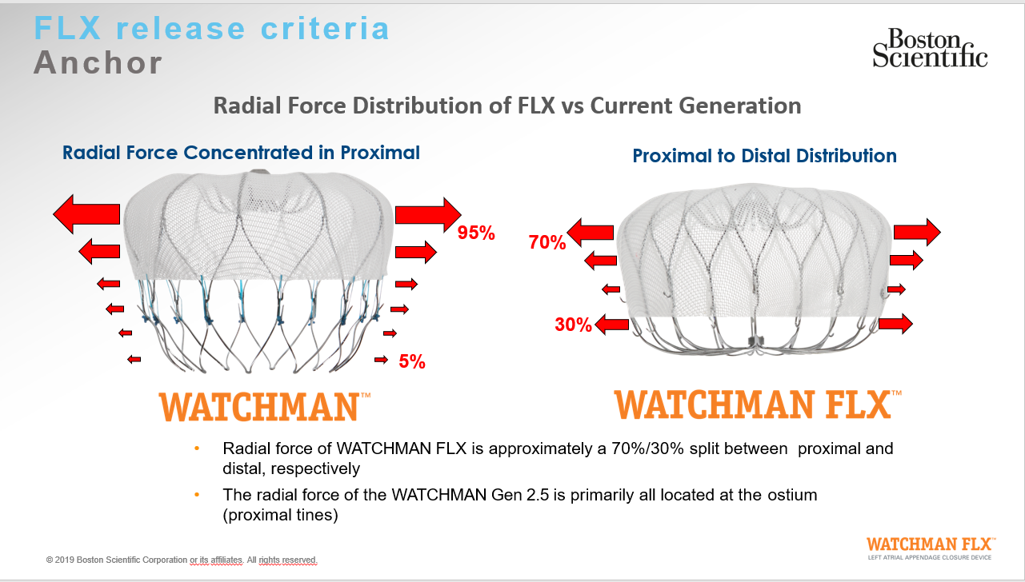
Watchman 2.5 vs Watchman FLX

Slide 16
CONCLUSION
LAA occlusion using ICE guidance is possible and reproducible.
Evaluation of deployment with PASS criteria needs to be adapted
Watchman FLX is expected to provide easier sizing in cases where depth is limited

