Slide 1
Management of Atrial Fibrillation Patients Undergoing PCI:
The Evidence Supports Dual Pathway Inhibition
Akshay Bagai MD, MHS
Interventional Cardiologist
St. Michaels Hospital, Unity Health Toronto
October 25, 2019

Slide 2

How could a nice guy like
Alexis Matteau get this so wrong?

Slide 3

How could a nice guy like
Alexis Matteau get this so wrong?

Slide 4
Disclosures
consultant to
  Bayer
  Servier
  BMS/Pfizer
  AstraZeneca
  Boehringer Ingelheim

Slide 5
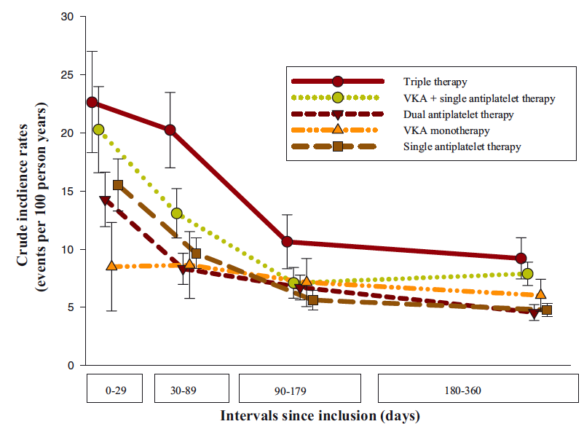
Lamberts et al JACC 2013
Even prior to contemporary trials on dual pathway using DOACs, there was little doubt that triple therapy is associated with greater bleeding than dual pathway

Slide 6
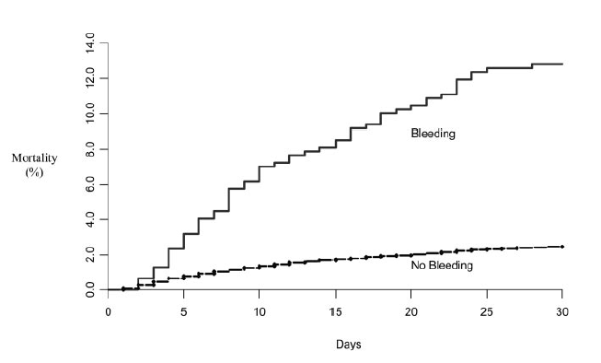
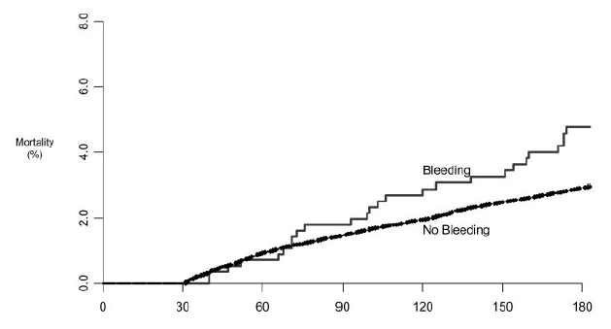
Bleeding is not as benign as previously thought
Death due to bleeding itself, interruption of antiplatelet/antithrombotic therapy
Reduction of bleeding worthwhile goal
Eikelboom et al. Circulation 2006

Slide 7
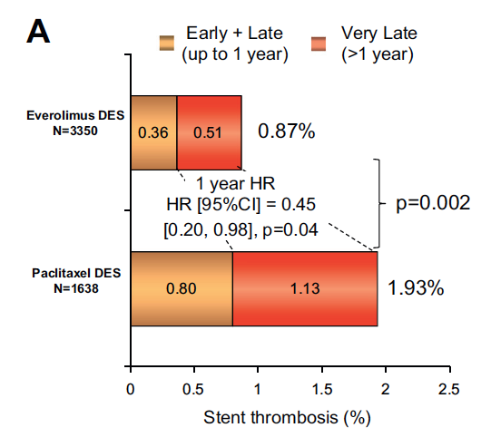
Risk of stent thrombosis significantly lower with current generation drug eluting stents
Thinner stent struts; thrombus resistant polymer
Improved vascular healing and endothelialization
Dangas et al. JACC Int 2013

Slide 8
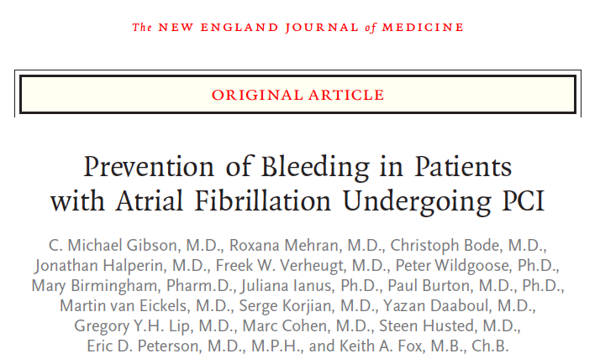
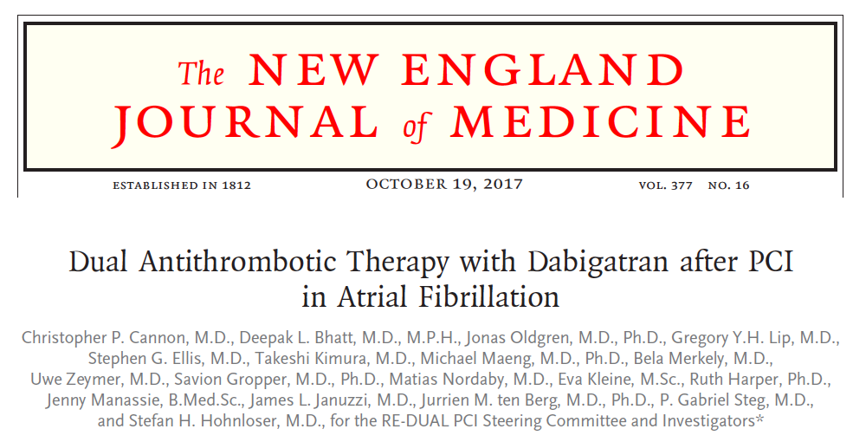
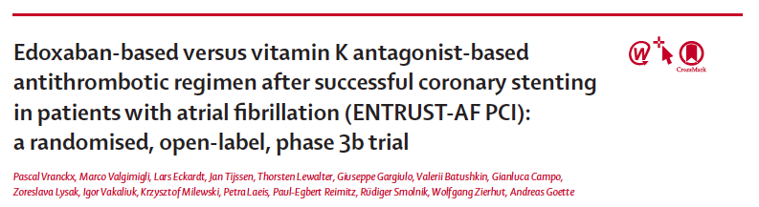
Contemporary Trials of Dual Pathway using DOACs vs. Triple Therapy

Slide 9
Study Characteristics
 | PIONEER | REDUAL | AUGUSTUS | ENTRUST
n | 2100 | 2725 | 4614 | 1506
DOAC | Rivaroxaban 15mg (*X% 10mg) | Dabigatran 110mg & 150mg | Apixaban 5mg (10% 2.5mg) | Edoxaban 60mg (20% 30mg)
Clopidogrel | 95% | 88% | 93% | 92%
Comparison | Vit K TT | Vit K TT | TT (Vit K + apixaban) | Vit K TT
ACS | 50% | 50% | 61% | 52%
Time to randomization after PCI/ACS | Within 72h | Within 120h | Median 6 days | Median 45h

Slide 10
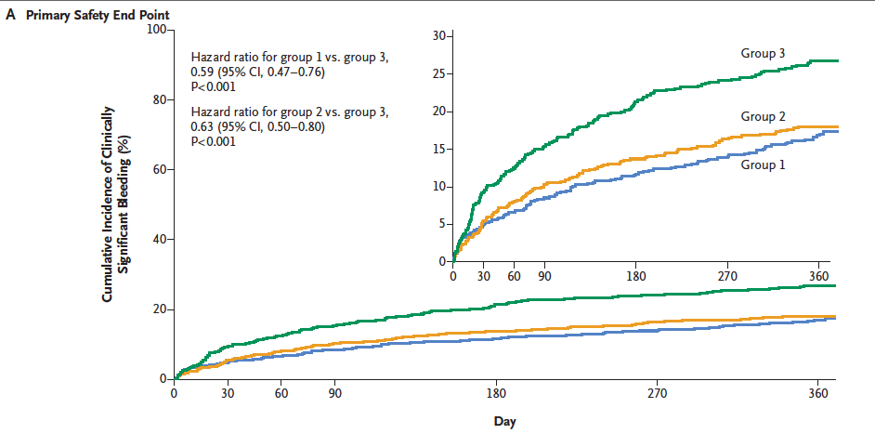
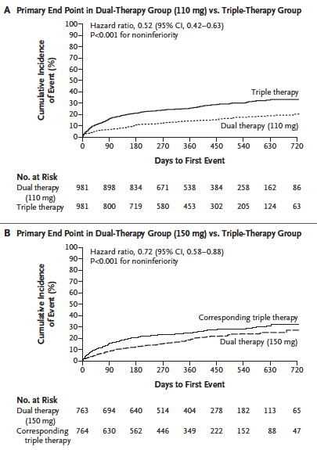
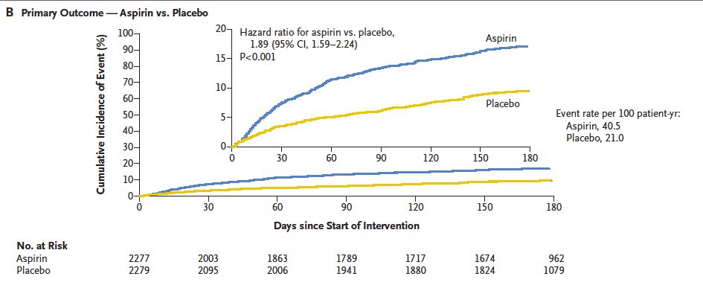
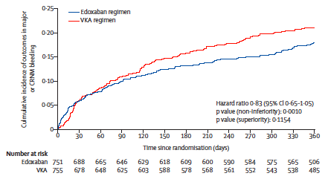
Contemporary trials confirm lower clinically relevant bleeding with Dual Pathway using DOACs vs. Triple therapy
PIONEER
REDUAL
AUGUSTUS
ENTRUST
Notes:
The construct was re-inforced just last month in this elegant paper by Roxanna Mehran – the first to be pubilshed in the DES era – again showing mortality rates that are lower by more than 2% absolute following successful versus unsuccessful recanalization of a CTO

Slide 11
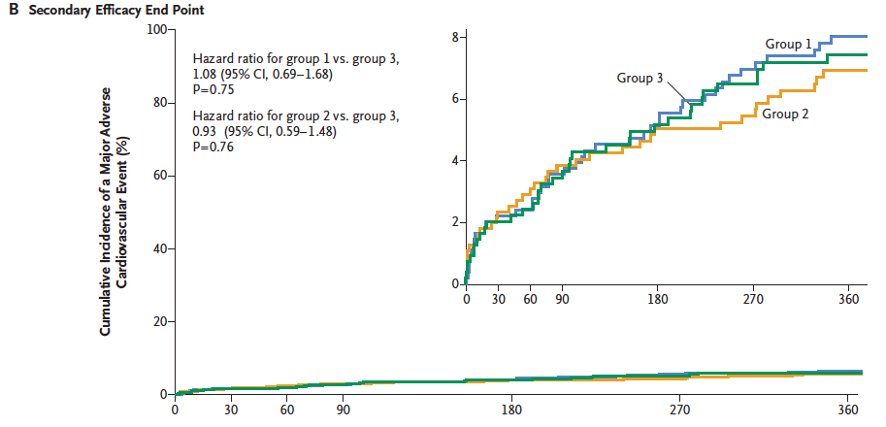
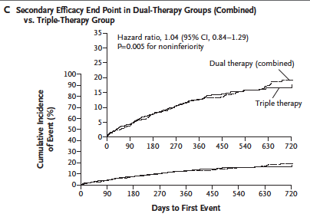
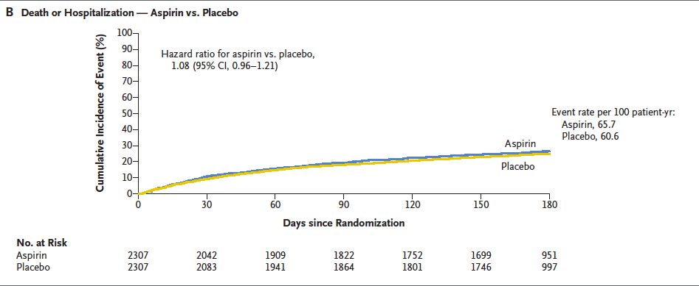
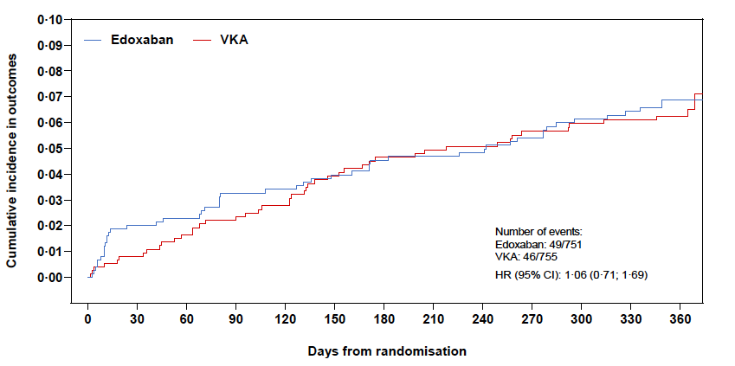
No increase in overall composite ischemic endpoints with Dual Pathway using DOACs vs. Triple Therapy
PIONEER
REDUAL
AUGUSTUS
ENTRUST
Notes:
result mainly driven by peri-procedural MI and repeat revasc’n
MI within 5d excluded: 36% had prior MI, 18% unstable angina

Slide 12
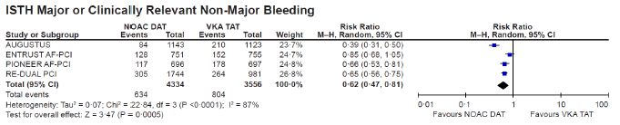
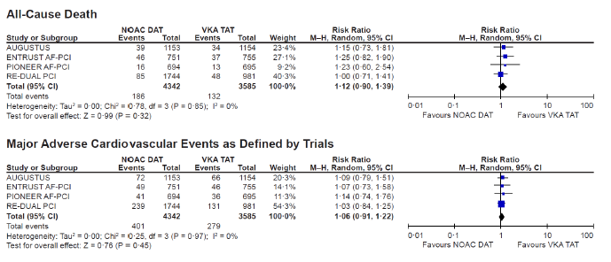
Contemporary trials confirm lower bleeding with Dual Pathway using DOACs vs. Triple therapy without increase in Ischemic Events
14.6%
22.6%
Vranckx et al. Lancet 2019

Slide 13
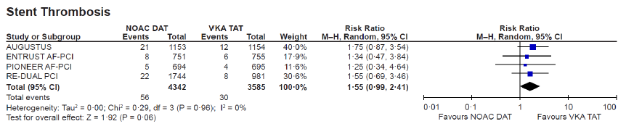
Adverse signal towards greater stent thrombosis with Dual Pathway
Event | Dabi 110 mg BID | Warfarin | HR (95% CI) | P Value
MI | 44 (4.5) | 29 (3.0) | 1.51 (0.94–2.41) | 0.09
Stent thrombosis | 15 (1.5) | 8 (0.8) | 1.86 (0.79–4.40) | 0.15
REDUAL
Endpoint | Aspirin (N=2307) | Placebo (N=2307) | HR (95% CI)
Death / Ischemic Events (%) | 6.5 | 7.3 | 0.89 (0.71–1.11)
Myocardial Infarction (%) | 2.9 | 3.6 | 0.81 (0.59–1.12)
Definite or Probable Stent Thrombosis (%) | 0.5 | 0.9 | 0.52 (0.25–1.08)
AUGUSTUS
1.3%
0.8%
Vranckx et al. Lancet 2019

Slide 14
Implications for ASA
Highest risk period for stent thrombosis early within 1-2 weeks after PCI
Clopidogrel the P2Y₁₂ inhibitor in 93%
  Uncertainty regarding its response variability and efficacy, particularly without aspirin
Clinical decision making should be based on a balanced assessment of competing coronary ischemic and bleeding risk
High risk of bleeding and low risk of thrombotic events → early omission of aspirin
Complex, multivessel PCI or high-risk ACS → greater duration of aspirin

Slide 15
2018 CCS/CAIC Update APT Guidelines
AF and elective PCI without high-risk features
Age < 65 and CHADS2 = 0
Age ≥ 65 or CHADS2 ≥ 1
Strong recommendation
Strong recommendation
ASA + Clopidogrel up to 12 months
For BMS: at least 1 month
For DES: at least 3 months
OAC + Clopidogrel up to 12 months
For BMS: at least 1 month
For DES at least 3 months
Strong recommendation
Strong recommendation
For extended treatment:
ASA alone
Add P2Y₁₂ inhibitor if high thrombotic risk features develop, low bleed risk
For extended treatment:
OAC alone
Add P2Y₁₂ inhibitor or ASA if high thrombotic risk features develop, low bleed risk
2018 CCS/CAIC Focused Update of the Guidelines for the Use of Antiplatelet Therapy
Notes:
1 A PCI is considered high-risk based on clinical and angiographic features such as: diabetes mellitus, prior ACS, chronic renal dysfunction (creatinine clearance < 60 mL/min), prior stent thrombosis, current smoker, multi-vessel disease, multiple stents implanted, complex bifurcation lesion, total stent length > 60 mm, chronic total occlusion intervention or bioabsorbable vascular scaffold (BVS) implantation.
2 OAC regimens evaluated in this context include rivaroxaban 15 mg daily (10 mg in patients with renal dysfunction), dabigatran 110 mg or 150 mg BID and warfarin. If warfarin is to be used, recommended INR target is 2.0-2.5. All patients should receive a loading dose of ASA 160 mg at the time of PCI (if previously ASA naïve). Thereafter, ASA can be discontinued as early as the day following PCI.
3 Extended treatment with a P2Y12 inhibitor can be added to ASA if high-risk clinical or angiographic features of ischemic events develop and low risk of bleeding.
4 The dose of OAC beyond the initial period of antithrombotic therapy (up to a year after PCI) should be standard stroke prevention doses as per the CCS Atrial Fibrillation Guidelines. Single antiplatelet therapy with either ASA or clopidogrel may be added to OAC if high-risk clinical or angiographic features of ischemic events develop and low risk of bleeding.

Slide 16
CONNECT AF+PCI study
%
Bagai, Goodman et al. CCS 2018

Slide 17
Management of Patients with Atrial Fibrillation Undergoing PCI:
The Evidence Supports (the
Option for) Dual Pathway Inhibition
Choose Dual Pathway for the Appropriate Patient
Akshay Bagai MD, MHS
St. Michaels Hospital, Unity Health Toronto

Slide 18
Management of Patients with Stable CAD/PAD:
The Evidence Supports Dual Pathway Inhibition
Akshay Bagai MD, MHS
Interventional Cardiologist
St. Michaels Hospital, Unity Health Toronto
October 25, 2019

Slide 19
Disclosures
consultant to
  Bayer
  Servier
  BMS/Pfizer
  AstraZeneca
  Boehringer Ingelheim

Slide 20
CV death, MI or stroke
in the 1 year post-MI event free population
~1 in 5 patients, event-free for 1 year post-MI, will suffer CV death, MI, stroke within 3 y
Of the 20% of patients who experienced an event in the
3 year follow up, 40.8% experienced an MI, 18.6%
experienced stroke, and 40.6% died due to cardiovascular causes as their first event
The mean duration of follow-up was 2.5 years and the maximum follow-up was 5.5 years
Jernberg, T. et al. Eur Heart J 2015

Slide 21
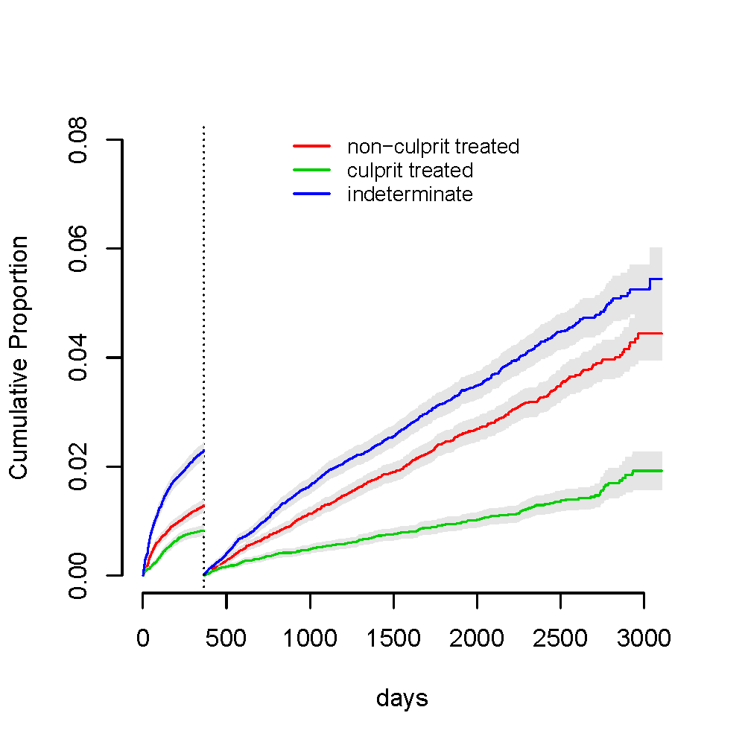
Risk of Future Coronary Events Determined By Entire Coronary Vascular Bed
0.08
0.06
indeterminate
0.04
non-culprit treated
Culmulative Proportion
culprit treated
0.02
0.00
0
500
1000
1500
2000
2500
3000
Days
Varenhorst et al J Am Heart Assoc. 2018 Jan; 7(1)
Notes:
Cumulative event probability och CI i tabellen är vid 8 år. Y-axeln i grafen överensstämmer inte med tabellen eftersom grafen är från en landmarkanalys med "nystart" vid ett år. Y-axeln går inte lika högt eftersom händelserna som skett innan ett år då är bortplockade

Slide 22
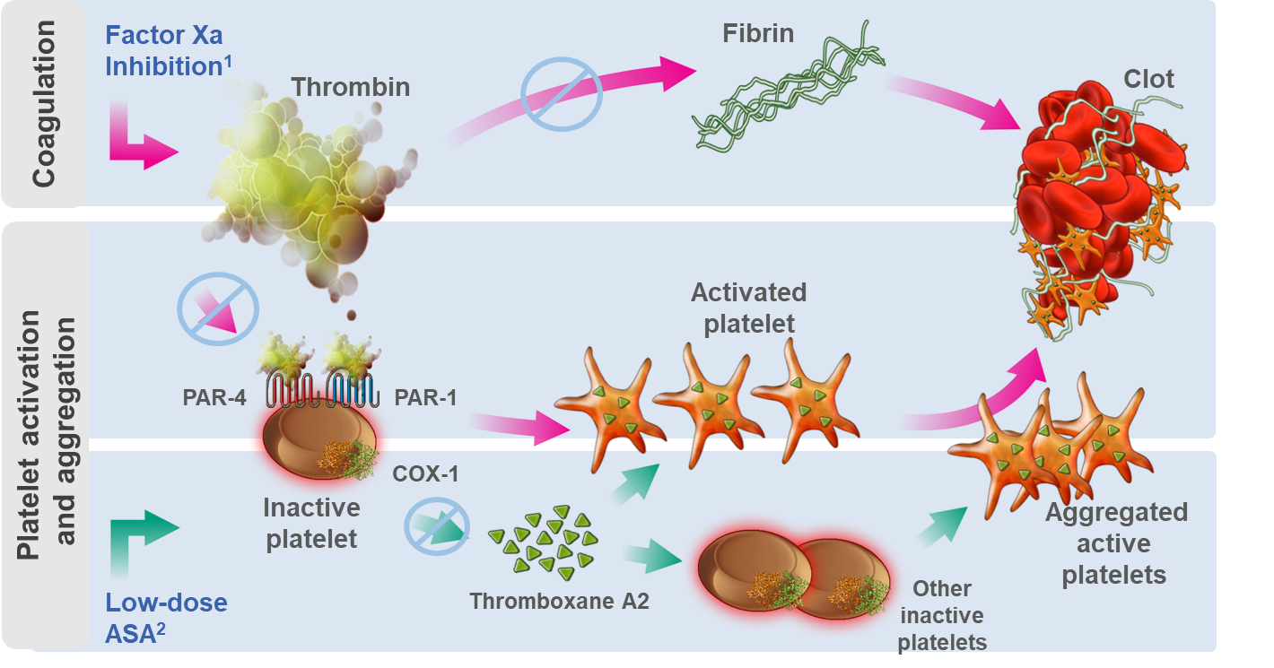
Dual Pathway Approach To Reduce CV Events

Slide 23
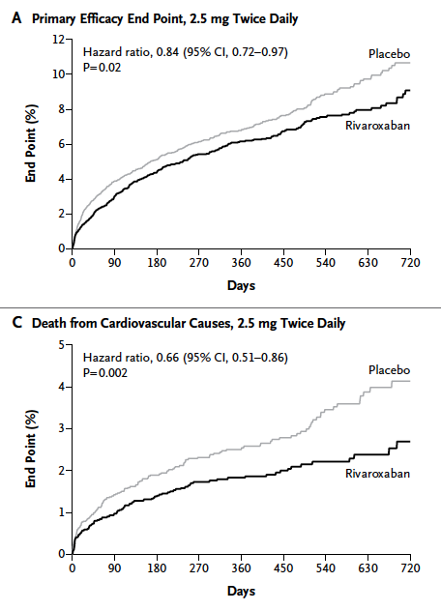
Addition of Rivaroxaban 2.5 BID to DAPT early after ACS reduced MACE including death from CV causes, but increased major bleeding and ICH
ATLAS TIMI 51
Mega et al. NEJM 2012

Slide 24
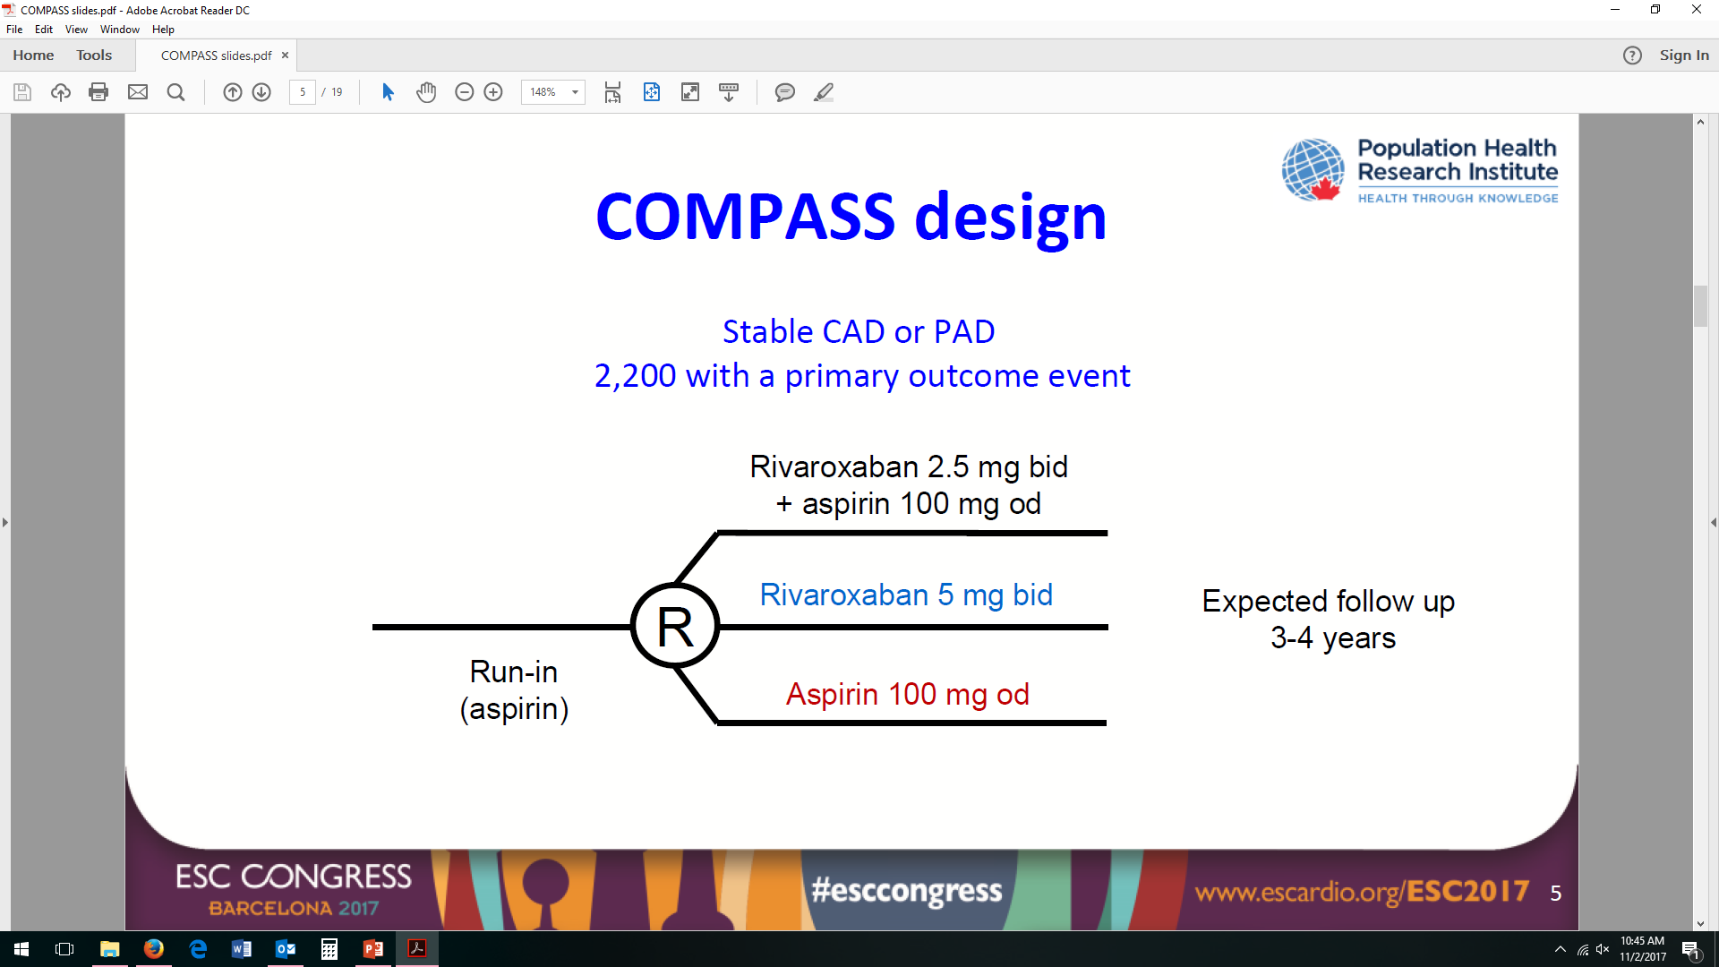
COMPASS Trial design
Designed to Enrich for High Risk and Polyvascular Disease
N=27,395
Stopped early for superiority
Mean f/u 24 months
Adapted from: Eikelboom JW, et al. N Engl J Med 2017;377:1319-30

Slide 25
CAD Inclusion
Stable CAD
  MI within 20 years
  Multivessel CAD
  Prior MV PCI or MV CABG
Atleast 65 yrs OR atherosclerosis in additional vascular bed OR atleast 2 risk factors (smoker, GFR <60, HF, non-lacunar stroke)

Slide 26
COMPASS Trial – Efficacy Results
CV death, MI, stroke
1.3% lower
Eikelboom et al. NEJM 2017

Slide 27
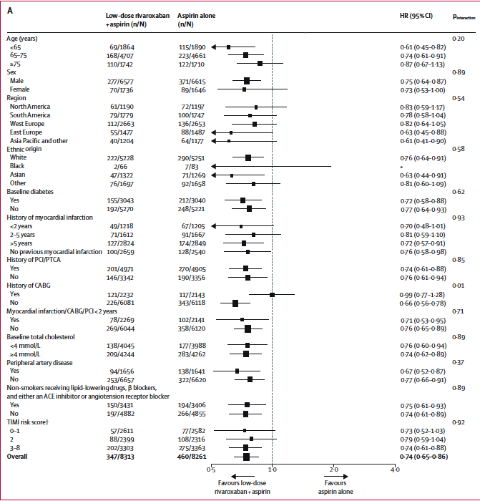
Connelly et al. Lancet 2017

Slide 28
MACE or MALE or Major Amputation
Anand et al. Lancet 2017

Slide 29
COMPASS TRIAL: MAJOR BLEEDING RATES
HR, 1.70 (95% CI: 1.40–2.05);
P <0.001
1.2% greater
Percentage of patients with outcome (%)
HR, 1.43 (95% CI: 0.89–2.29);
P =0.14
HR, 1.49 (95% CI: 0.67–3.33);
P =0.32
HR, 1.10 (95% CI: 0.59–2.04);
P =0.77
Notes:
ISTH Major Bleeding Criteria were modified for this trial at the request of the FDA. All bleeding that led to presentation to an acute care facility or hospitalization was considered major.

Slide 30
Treatment Efficacy and Safety of Ticagrelor and Rivaroxaban in Addition to ASA for Longer Term Treatment Post ACS
 | Ticagrelor 60mg BID arm in PEGASUS | Rivaroxaban 2.5 BID CAD arm in COMPASS
CV death/MI/stroke rate in control group | 9% at median 33 months | 6% at mean 24 months
CV death/MI/stroke | ⬇16% | ⬇26%
CV death | ⬇17% | ⬇28%
MI | ⬇16% | ⬇14%
Stroke | ⬇25% | ⬇44%
Major bleeding | ⬆130% | ⬆66%
Exclusions due to non-adherence and adverse effects in run in period

Slide 31
 | Ticagrelor 60mg BID arm in PEGASUS | Rivaroxaban 2.5mg BID CAD arm in COMPASS
Age | 65 | 69
Male | 76% | 79%
Diabetes | 33% | 37%
PAD | 5% | 20%
Prior MI | 100% | 68%
Time from MI | Median 1.7yrs | Median 7.1yrs
Prior PCI | 84% | 60%
Multivessel CAD | 60% | 63%

Slide 32
Two Effective Therapies With Reasonably Acceptable Bleeding Risk
If no significant bleeding on DAPT during 1st year after ACS, nor at increased risk for bleeding, consider particularly among patients at higher risk for CV events, both
  Continuation of P2Y₁₂
  Switching P2Y₁₂ to Rivaroxaban

Slide 33
My Personal Potential Differentiators
Potent antiplatelet and antithrombotic strategies both reduce ischemic risk and increase bleeding but with net benefit and mortality reductions in the highest risk populations
 | P2Y₁₂ receptor inhibitor | Rivaroxaban
Polyvascular disease |  | ✔
Recurrent MI/PCI | ✔
Complex PCI | ✔
Prior stent thrombosis | ✔
Time of MI
1-3 yrs ago | ? ✔
>3 yrs ago |  | ? ✔

Slide 34
Management of Patients with Stable CAD/PAD:
The Evidence Supports (the
Option for) Dual Pathway Inhibition
Choose Dual Pathway for the Appropriate Patient
Akshay Bagai MD, MHS
St. Michaels Hospital, Unity Health Toronto

Slide 35
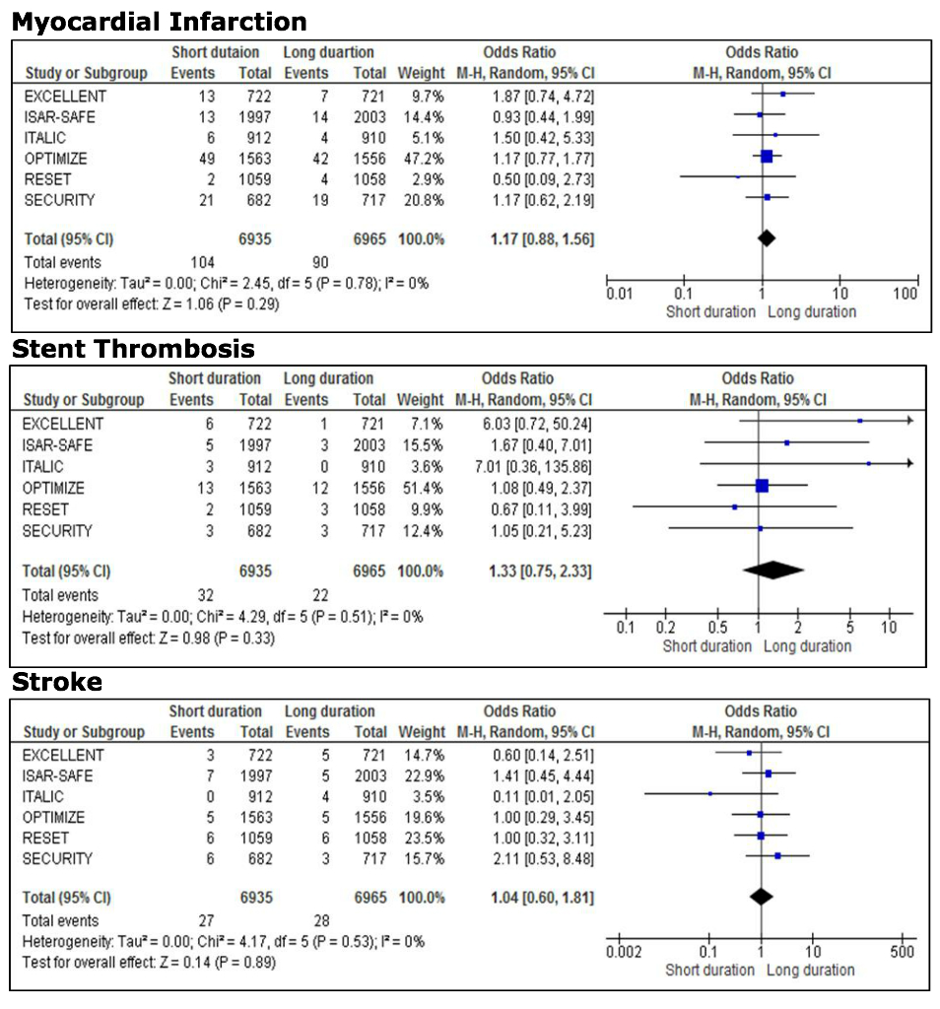
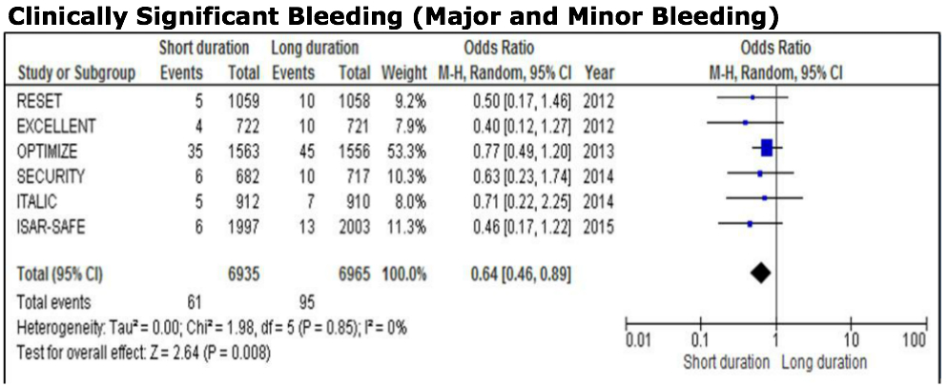
Duration of DAPT can be safely shortened in stable non-ACS patients undergoing PCI
Clinically significant bleeding
Wassef, Bagai et al. JIC 2016

Slide 36
COMPASS PAD – limb risk by PAD history
Incidence of MALE (%)
N=86
N=37
N=5
N=2264
36% of Population
N=2705
42% of Population
N=1422
22% of Population

Slide 37
ANALYSIS INDICATES POTENTIAL IMPROVEMENT
IN BENEFIT-RISK OVER TIME: EFFICACY MAINTAINED, BLEEDING RISK REDUCED
Landmark analysis for key efficacy and safety outcomes
Time from Randomization | Rivaroxaban 2.5 mg BID + ASA n/N (%) |  | ASA Alone n/N (%) |  | HR (95% CI) | HR (95% CI)
MACE
<1 year | 176/8313 | (2) | 221/8261 | (3) |  | 0.79 (0.65–0.96)
1–<2 years | 113/7228 | (2) | 169/7125 | (2) |  | 0.66 (0.52–0.83)
>2 years | 58/3655 | (2) | 70/3621 | (2) |  | 0.82 (0.58–1.16)
Major bleeding
<1 year | 163/8313 | (2) | 70/8261 | (1) |  | 2.32 (1.75–3.07)
1–<2 years | 70/7189 | (1) | 59/7183 | (1) |  | 1.19 (0.84–1.68)
>2 years | 30/3626 | (1) | 29/3694 | (1) |  | 1.05 (0.63–1.75)
All deaths
<1 year | 117/8313 | (1) | 145/8261 | (2) |  | 0.80 (0.63–1.02)
1–<2 years | 93/7323 | (1) | 120/7242 | (2) |  | 0.77 (0.59–1.01)
>2 years | 52/3743 | (1) | 74/3762 | (2) |  | 0.70 (0.49–1.00)
0.1
1
10
Favours
Riva 2.5 mg bid
+ ASA
Favours
ASA alone
Notes:
Notes
There is an apparent increasing benefit in all-cause mortality over time, suggesting the ultimate measure of net benefit improves over time.
This was a post hoc landmark analysis that examined the effects of treatment during year 1, year 2, and beyond year 2. This analysis suggests that the risk of bleeding from the addition of vascular dose rivaroxaban to ASA decreases after the first year, whereas the reduction in the primary outcome remains relatively stable throughout all time points.
The point estimate for all-cause mortality shifts toward the left over time, favouring the vascular dose rivaroxaban + ASA group compared with ASA alone, with the hazard ratio increasing from 20% at year 1 to 30% beyond 2 years.

Slide 38
2018 CCS/CAIC Update APT Guidelines
Factors associated with increased bleeding risk
Need for OAC in addition to DAPT
Advanced age (> 75 years)
Frailty
Anemia with hemoglobin < 110 g/dL
Chronic renal failure (creatinine clearance < 40 mL/min)
Low Body Weight (< 60 kg)
Hospitalization for bleeding within last year
Prior stroke/intracranial bleed
Regular need for NSAIDS or prednisone

